Slide 1



Toolbox Talk – March 2021

Slide 2
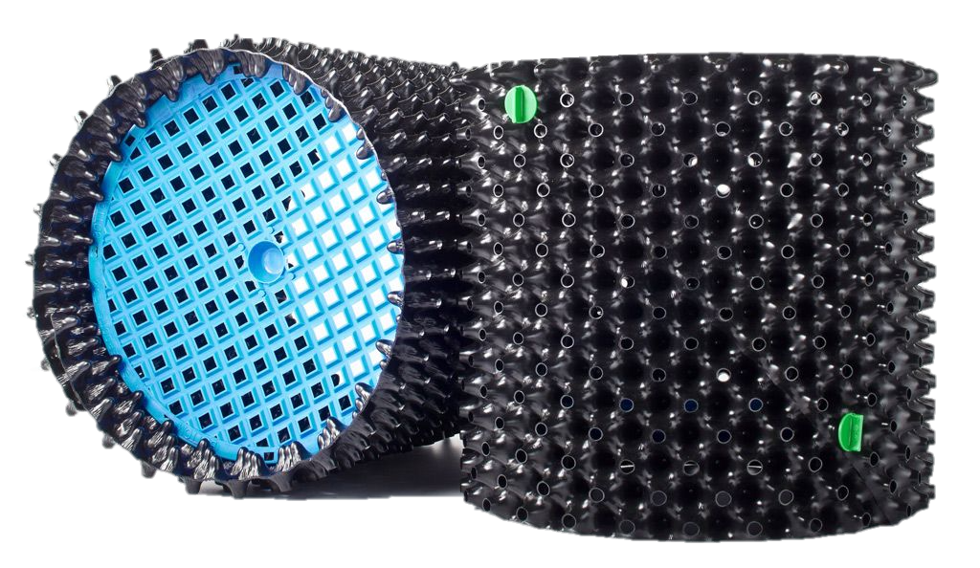

What is an Air-Pot?
The Air-Pot is a revolutionary planting container.
Its design actively enhances the growth and health of plants.

Slide 3
About the Air-Pot system
They are made in Scotland from 100% UV stabilised recycled plastic.
The Air-Pot container has been continually refined over twenty years and is now in its sixth generation.
It’s the original and best root-enhancement system. Every detail has been enhanced to guarantee healthy root development and maximum aeration.
They are tough and robust and can last up to ten years or more – even in strong, tropical sunshine.

Slide 4
About the Air-Pot system
For plants to thrive they need healthy roots, but standard pots deform roots which seriously compromises the plant.
The Air-Pot system does the opposite, actively enhancing the plant, by making it develop a mass of healthy fibrous roots.

Slide 5
How Air-Pot containers work
Air-Pot containers bring about better growth in two ways:
  Better aeration of the growing medium means healthy bacteria can release more nutrients to the plant.
  The shape of the pot wall air prunes the roots, making the plant develop a mass of healthy fibrous roots.
This maximises the plant’s ability to absorb nutrients and water, leading to a healthier, faster growing plant.
1
2

Slide 6
How Air-Pot containers work (cont.)
1. Taproot pruning
2. Lateral root pruning
3. Fibrous root mass develops
When the tap root reaches the base, increased air in the growing medium dehydrates the tip, pruning it and stimulating lateral root branching.
Each of the lateral roots is then steered by the shape of the wall towards an air hole, where it is also air-pruned, causing yet more branching.
The process is continually repeated until the plant has developed a dense mass of fibrous roots.

Slide 7

Benefits of Air-Pot
Councils, Nurseries and Botanical Gardens

Slide 8
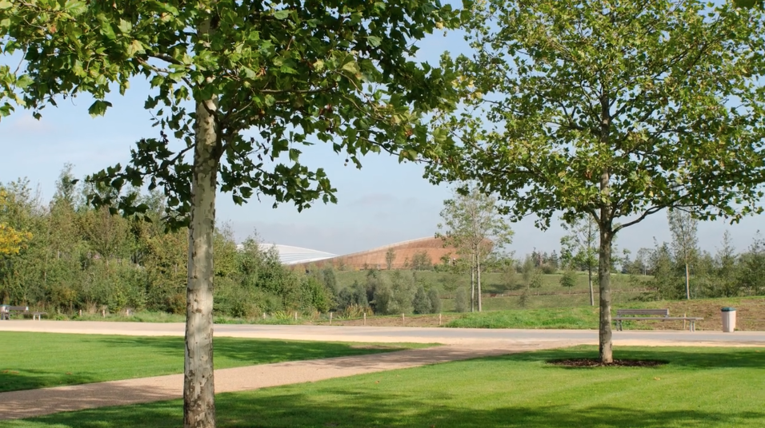
Councils
Faster growth
Trees are ready for projects sooner and stay in peak condition for longer.
Greater resistance to disease
Healthier trees have a higher resistance to disease which means less expenditure on pesticides and fungicides.
Flexible planting
Planting is possible at any time of the year allowing much greater flexibility for Council landscapers working on projects with narrow deadlines or strict planning requirements.

Slide 9
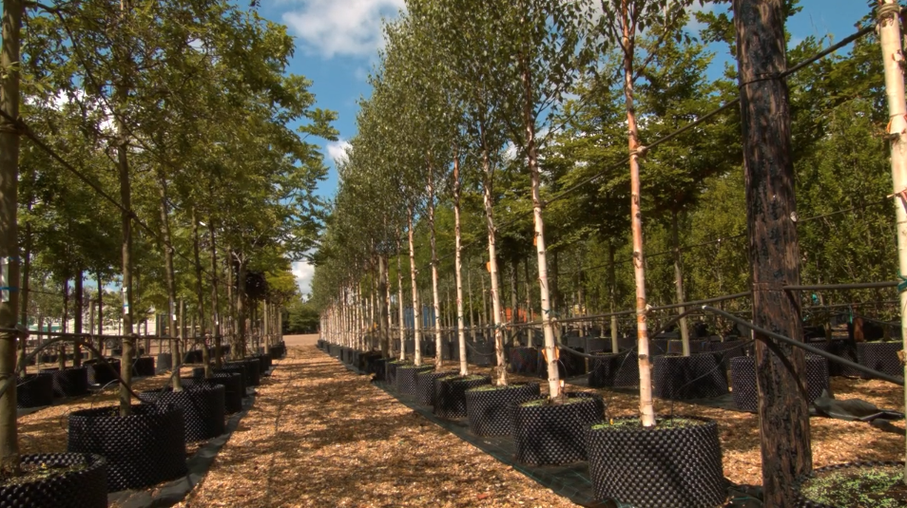
Councils (cont.)
No transplant shock
Instant establishment and zero losses means no tree replacement costs.
Lower Costs
Less potting on, along with all the other benefits of growing with Air-Pot containers, means less work and lower labour costs.
Environmentally responsible
Air-Pot containers are made from recycled plastic. Trees grown in Air-Pot containers grow 40% faster, depending on species, and absorb at least an additional 4kg of CO2 each year.

Slide 10
Nurseries
Faster growth
Trees grow quicker in Air-Pot containers and can be ready for delivery in half the time, leading to faster turnover of stock, better cash flow, and bigger profits.
Lower costs
Air-Pot grown plants need re-potting less frequently meaning lower labour costs, while their increased resistance to disease means less time and money spent on treatment with fungicides and pesticides.
Reusable for many years
Air-Pot containers are made from tough recycled plastic which will last for up to ten years, even outside in strong sunshine.

Slide 11
Nurseries (cont.)
Greater flexibility
Plants can stay in the Air-Pot container for an extra year rather than be sold off at discounted prices. Or you can pot up for a more valuable plant next season.
Healthier plants
The health of Air-Pot grown plants means they sell quicker and for higher prices. The fantastic root system means better establishment when planted out, there are no losses to replace, and happy customers return to order more.
Easier handling
The dense straight-sided root ball makes Air-Pot grown trees easy to transport and plant, with no waste being taken to the site.

Slide 12
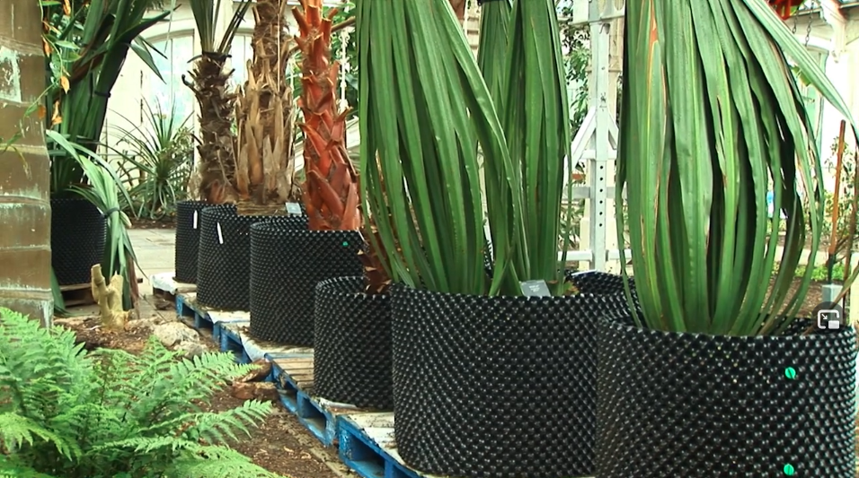
Botanical Gardens
Propagating Endangered Species
Radically improve the health and long-term survival of your trees.
Research and conservation
Botanical Institutions around the world trust the Air-Pot® system to produce the finest possible plant specimens for their academic research and conservation work.
Greater resistance to disease
Healthier trees have a higher resistance to disease which means less expenditure on pesticides and fungicides.

Slide 13
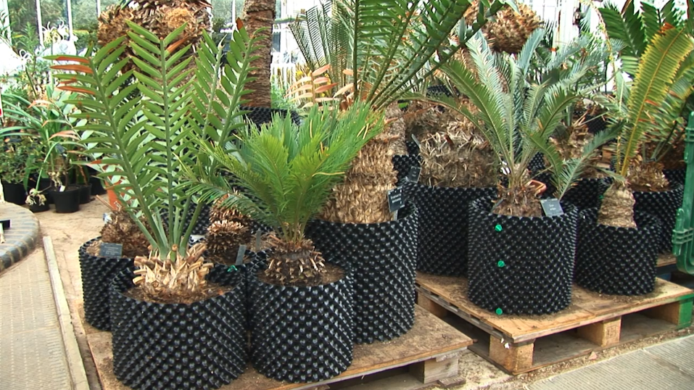
Botanical Gardens (cont.)
Faster establishment with no loss
Instant establishment and zero losses means no tree replacement costs.
Lower costs
Less potting on, along with all the other benefits of growing with Air-Pot containers, means less work and lower labour costs.
Environmentally responsible
Air-Pot containers are made from recycled plastic. Trees grown in Air-Pot containers grow 40% faster, depending on species, and absorb at least an additional 4kg of CO2 each year.

Slide 14
Root Comparison
Former pot-in-pot system
Constriction of the trunk foot by roots after six years. This tree gradually died.
Former Air-Pot container
Normal radial rooting after eight years.

Slide 15
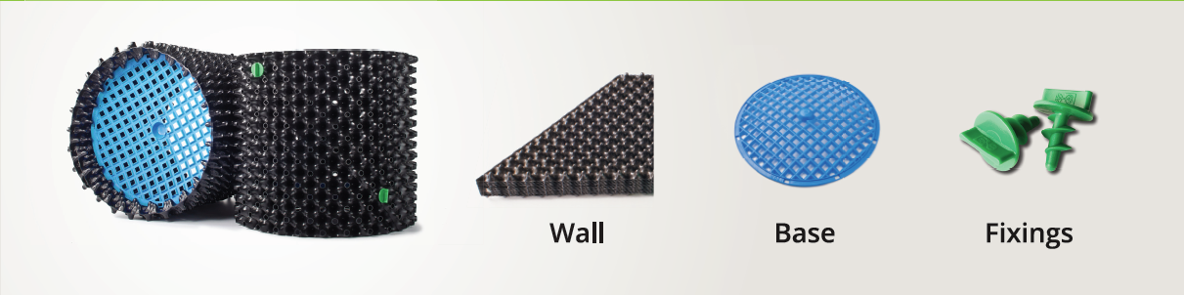
Components

Slide 16
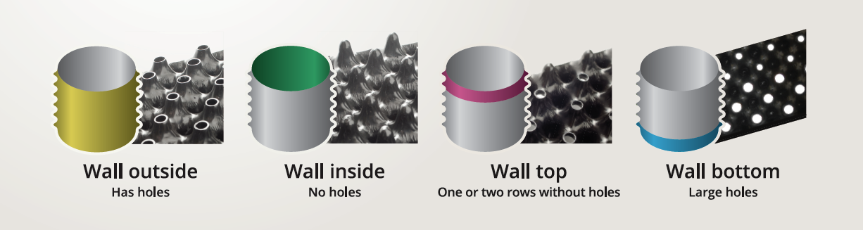
Components

Slide 17
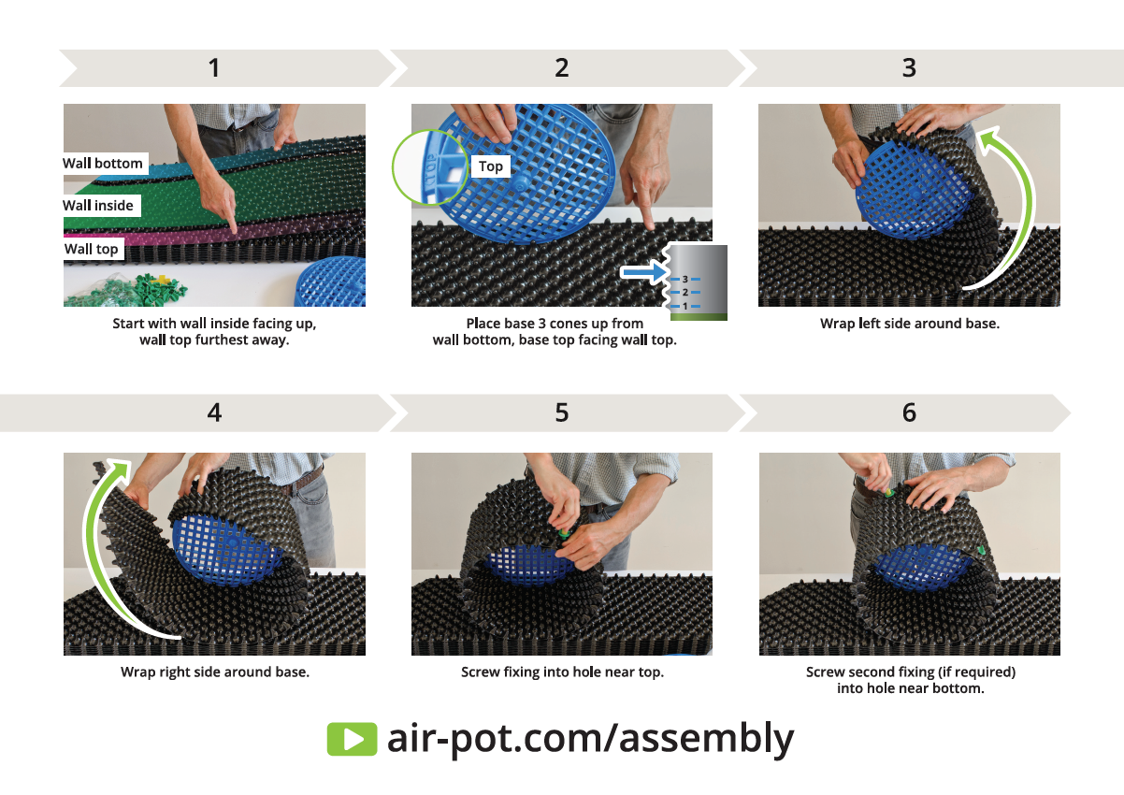
Assembly
For Air-Pot containers to work properly it’s essential that they are assembled correctly.
The cones with holes must be on the outside, the row of uncut cones that forms the water reservoir at the top, and the base three rows of cones up from the bottom.

Slide 18
Assembly (cont.)

Slide 19
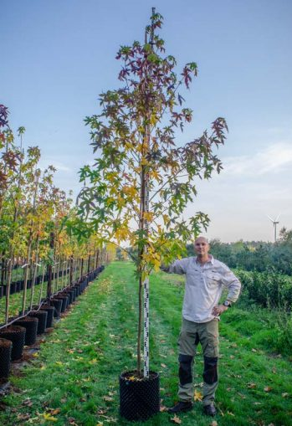
Growing with Air-Pot
Realising the full benefits of growing with Air-Pot containers requires a fundamentally different approach to growing with standard pots and should include changes to your whole system.
Growing Media. The design of the Air-Pot container requires a finer grade of growing medium to allow filling of the cones so that roots can be air pruned.
Irrigation. The greater mass of healthy roots means that plants will absorb more water and therefore require a different irrigation regime.
Nutrition. The healthy roots and faster growth will also mean that the plants will require more nutrients.

Slide 20
Growing with Air-Pot
Growing Medium
A finer mix. The growing environment is highly aerated, so the growing media must have a lower air fill porosity and be a finer mix.
Well-filled cones. For the air pruning process to work effectively the cones on the wall of the Air-Pot container must be well filled.
Eliminates anaerobic conditions. The design of the Air-Pot wall eliminates the anaerobic problem and therefore possible for a finer compost mix to be well compacted into the container.
Anaerobic: Absence of oxygen or growing in the absence of oxygen. Soils that are heavy textured (clay), compacted, wet or flooded tend to be anaerobic because they have less oxygenated air to carry out oxidative reactions.

Slide 21
Growing with Air-Pot
Filling the container
To get the best out of Air-Pot containers it is essential that they are correctly filled.
1
Loosely fill the container three quarters full.
2
3
Repeat the process until full and insert the plant.
5
Firm in more compost until full to the top.
6
The cones should be well filled with compost.
Vigorously firm
the compost down and into the cones.
Until the volume of com-post is well reduced.
4

Slide 22
Growing with Air-Pot
Irrigation & Nutrition
Air-Pot grown plants require more nutrient and water than plants in standard containers, due to the greater mass of heathy roots and faster growth.
It is essential that drip irrigation is used – with sufficient drippers in each container – to allow even distribution of water to the whole root system. For small containers this means two drippers, for larger ones four or even more.
It is essential that the Air-Pot containers are set up in a separate irrigation zone.

Slide 23
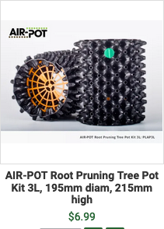
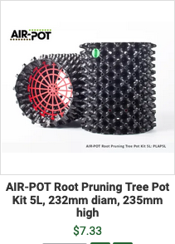
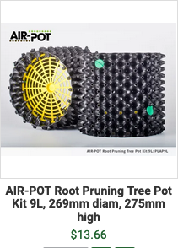
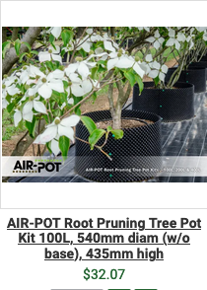
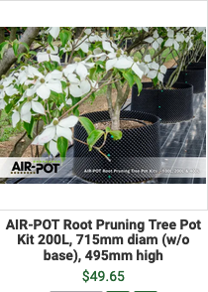
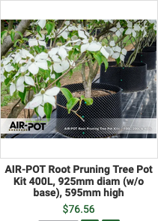
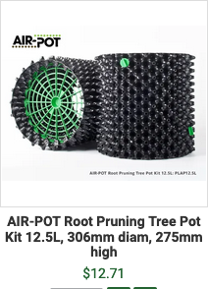
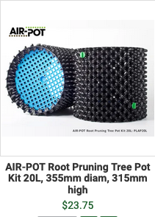
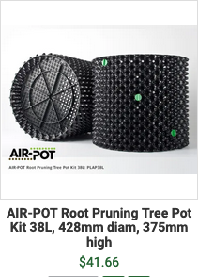
Pot sizes
https://arborgreen.com.au/tag/2-brand/value/761-air-pot
100L Kit
200L Kit
400L Kit
3L (Orange)
5L (Red)
9L (Yellow)
POPULAR
12.5L (Green)
20L (Blue)
38L (Black)

Slide 24
Air-Pot and CO²
Trees in Air-Pot containers grow at least 40% faster than those in normal plant pots.
40% faster growth means 40% more CO2 is is taken out of the atmosphere.
A small tree in a standard container absorbs 5.9Kg per annum, a ten-year-old tree 21.8kg per annum. To be conservative we will use a figure of 10kg per annum per tree.
With 40% faster growth, trees will absorb at least an additional 4kg of CO2 each year, as a result of being in an Air-Pot container.

Slide 25
Selling Air-Pot
Target Audiences:
Councils
Nurseries and Commercial Tree Growers
Botanical Gardens
Key Selling Points:
Faster growth
Healthier plants
Instant establishment with zero losses
Lower costs
Tough & robust, lasting up to 10 yrs. Stronger and more durable than competing products
Environmentally responsible
(see benefits for each target audience)

Slide 26
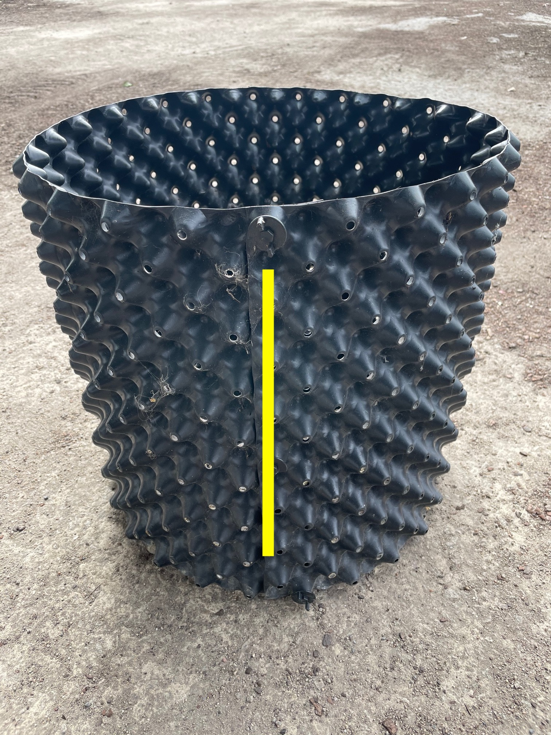
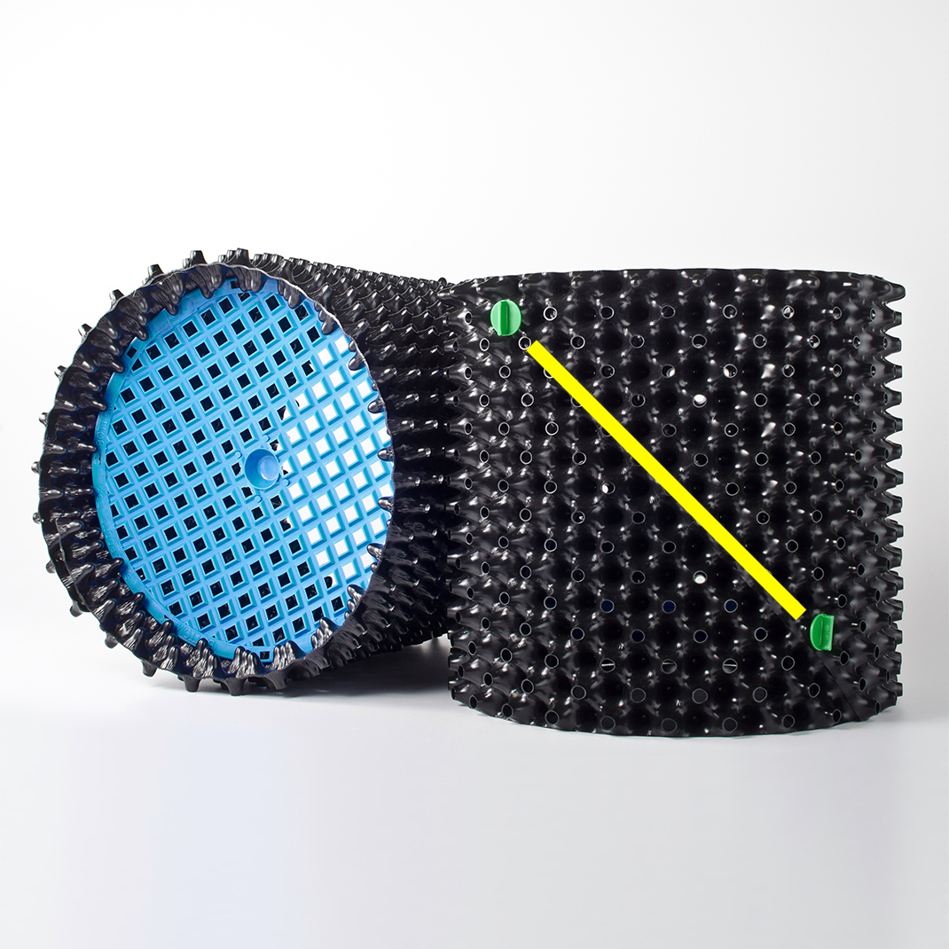
Selling Air-Pot
Competitors:
Root Builder Pots (from Ryset)
  Made in Korea
  Thinner plastic and only last a few years
  Join comes apart under pressure
  Holes at the top doesn’t provide a reservoir
Rocket Pot Australia
Both are knock-offs of the original Air-Pot.

