Slide 1


Root Ball Guying Systems
Toolbox Talk – August 2021

Slide 2
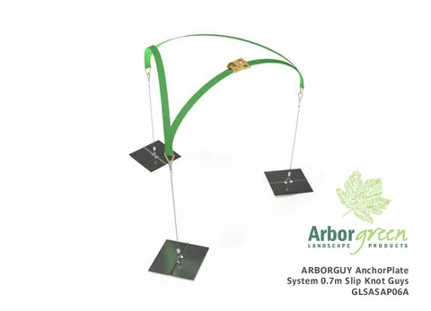
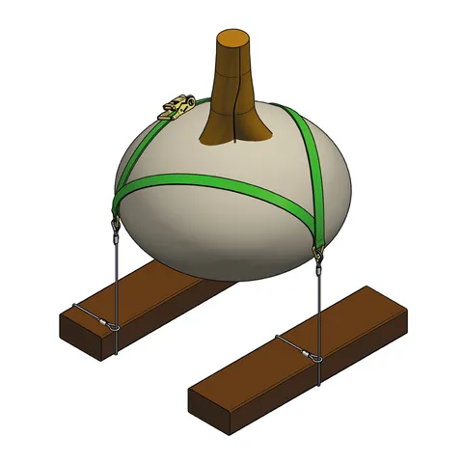
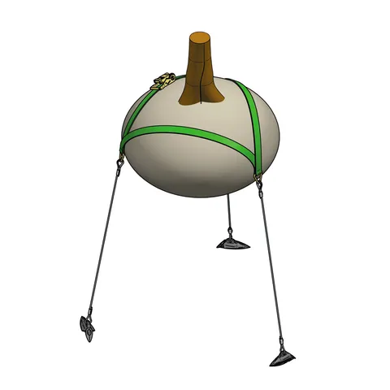

What is a root ball guying system?
We sell the Arborguy root guying systems
There are three types – dead man, anchor plate & aluminium anchor
They are buried in the ground with the root ball to prevent theft & wind damage – alternative to staking a tree
Very natural way to holding a tree down
Anchor Plate
Dead Man
Aluminium Anchor

Slide 3
Deadman System
Uses a sleeper or order workplace rubbish to hold the root ball down – relies on the weight of this to hold the tree in the ground
  Workplace rubbish is anything that is weighty and got a bit of surface area – e.g. multiple paving slabs, or concrete
There is a wire that has a loop in one end and a metal ‘eyelet’ in the other – the wire is passed around the weight, and the loop is passed over the ‘eyelet’ creating a tight hold on the weight
Ratchet straps are threaded in a triangle like pattern over the root ball, and through metal ‘eyelets’
These are then tightened to an appropriate level to hold the tree in place
Video: https://www.arborgreen.com.au/product/2914-arborguy-dead-man-system-1-25mtr
Approx: 1.26 min

Slide 4
Anchor Plate System
Same as the dead man system in principle
Instead of the sleeper or concrete it uses the metal plates
Comparison
Feature | Deadman | Anchor
Wire | Loop requirement | Comes fixed to the anchor plate
Weights | 1-3/tree | 3/tree
Install | Same method
Supplied with | Ratchet strap & wire | Anchor plates, wires & ratchet strap

Slide 5
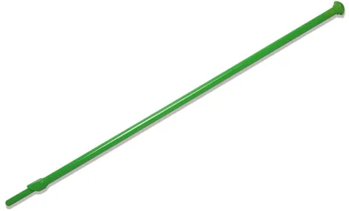
Aluminium Anchors
Medium and large size
Uses an anchor to hold the tree down
Anchor is driven into the ground with a special driver (sold separately)
The anchor head is then rotated in the ground by pulling hard on the wire
The same strapping method (ratchet strap) is then used to hold the root ball in place
1
2
Video: https://www.arborgreen.com.au/product/2914-arborguy-dead-man-system-1-25mtr
Approx: 2.30 min

Slide 6
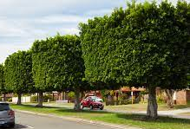
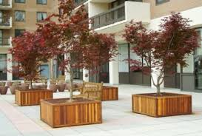
Why use guying systems?
Great for simulating natural tree holding in the ground
As it holds the tree from the base, it naturally stimulates root growth
No stakes or tree tie needed – better for the tree than those as well
Discrete – nothing above ground, but the tree is securely held
Range of options to suit different planting needs
  If planting in the ground and there is nothing below, the anchor system is most common
  If planting in a planter box, the anchor plate system is most common (you can simple screw the anchor plates to the bottom or side of the planter box – provided water proofing isn’t an issue)
    If water proofing is an issue, the dead man system would work best

Slide 7
Specs from Server (link below)
Link to server here

