Slide 1



Bighorn Products

Slide 2
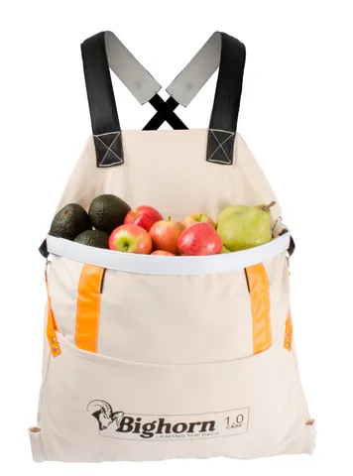
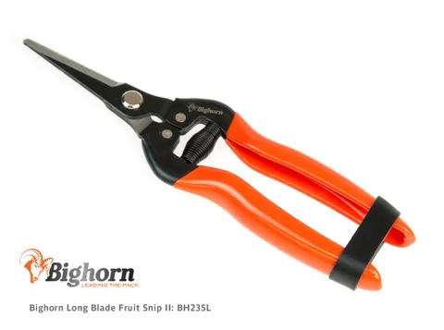
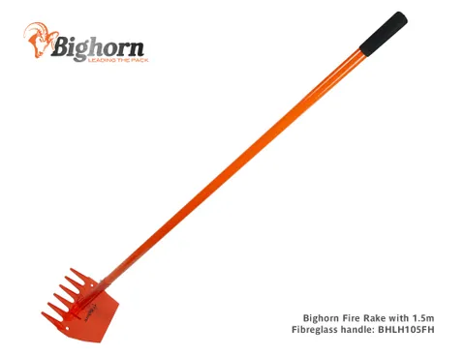


What is Bighorn?
Bighorn is our own brand – products that compete with other we sell, are priced at the lower end of the market (eg secateurs)
Basically, we use Bighorn as a brand in which we can add new, unique, products to give us an advantage over our competitors
What do we currently sell as ‘Bighorn’?
  Secateurs (both anvil and bypass)
  Fruit picking bags
  Fire rakes
  Post drivers
  Larger tools (scoops, forks, Staple gun etc)
  Fruit snips
  Loppers

Slide 3

Why do we sell/use Bighorn?
To be unique & flexible!!

Slide 4
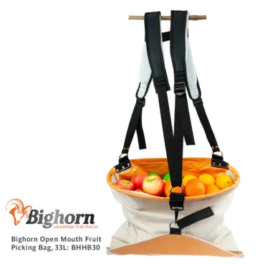
Fruit Picking Bags
Two types:
  Open mouth
  Hoop mouth
Hoop mouth – One size, padded straps, one release point on the hoop
Open mouth – come in multiple sizes, padded straps, two release points on the bag

Slide 5
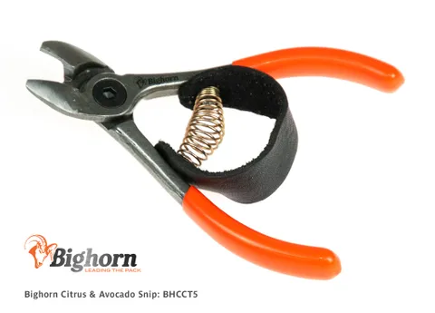
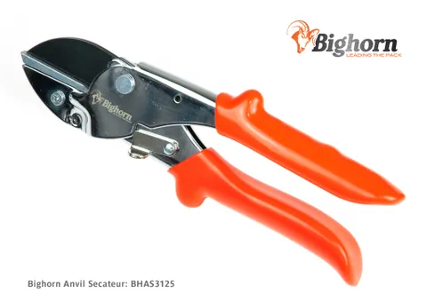
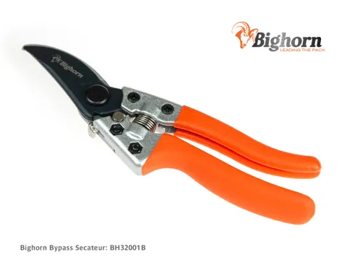
Secateurs/Snips
Two types:
  Bypass: Snips & Bypass Secateurs
  Anvil: Anvil secateurs & citrus snips
The Bighorn products on this slide have largely been developed to compete with ARS & Bahco. Obviously, the pricing is lower, and the product isn’t as good, but it does allow up the option to compete at the lower price point.
Same release mechanism as the ARS VS range

Slide 6
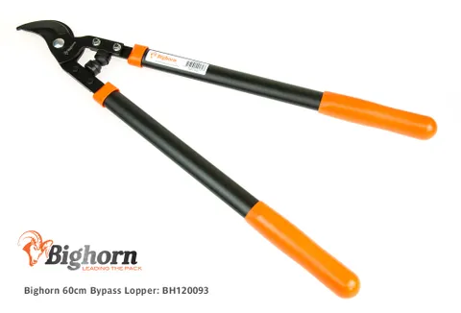
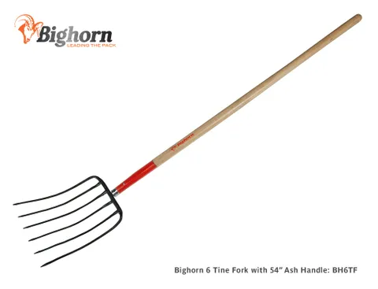
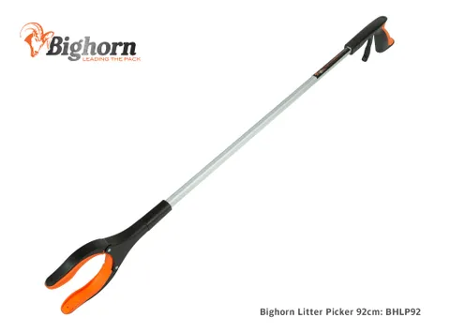

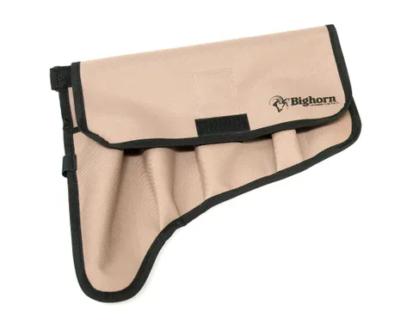
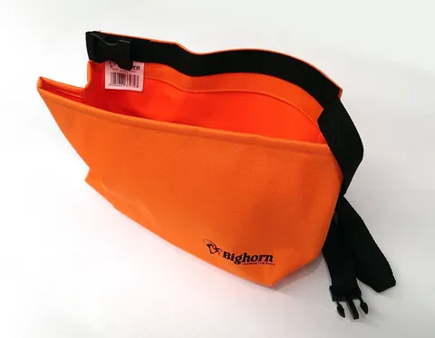
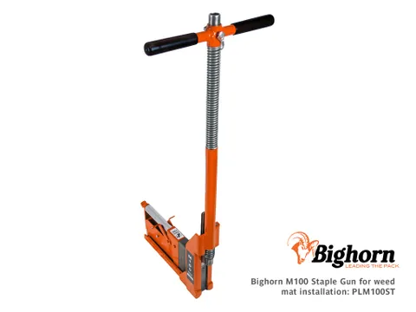
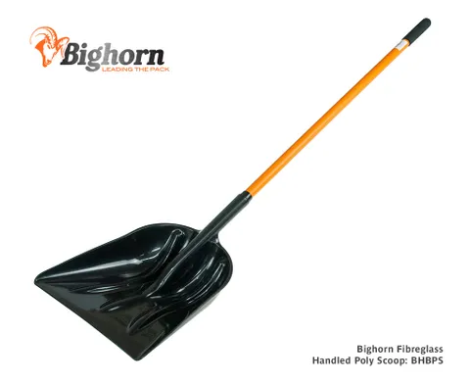
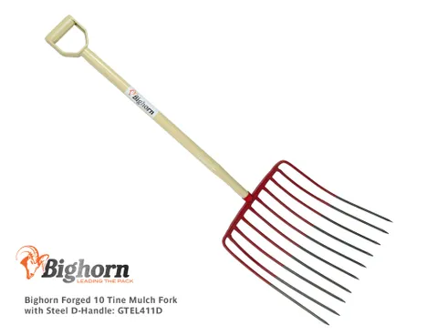
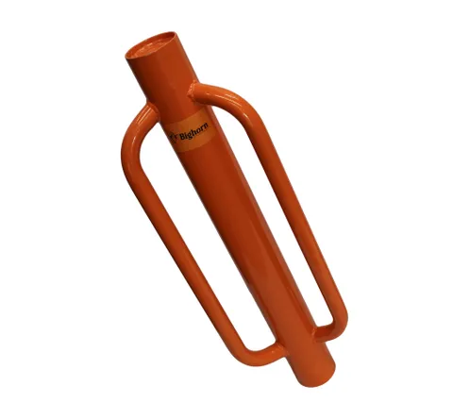
Other Bighorn Stuff
Bypass Lopper
6 Tine Fork
Litter Picker
Pouch & Belt
Staple Gun
Tie Pouch
Fire-Rake
Poly Scoop
10-Tine Fork
Post Driver

