Slide 1







Bio-Guard

Slide 2


What are we trying to achieve
Allows light in to encourage growth
Strong junctures at stake points
Weed spraying possible around guard
Compostable (home or industrial)
Desired attributes of a biodegradable guard
Easy for contractors to install
Volume similar to corflute guard
Cost point under $2/guard (including stake)
100% biodegradable
Minimum 18 month lifespan

Slide 3
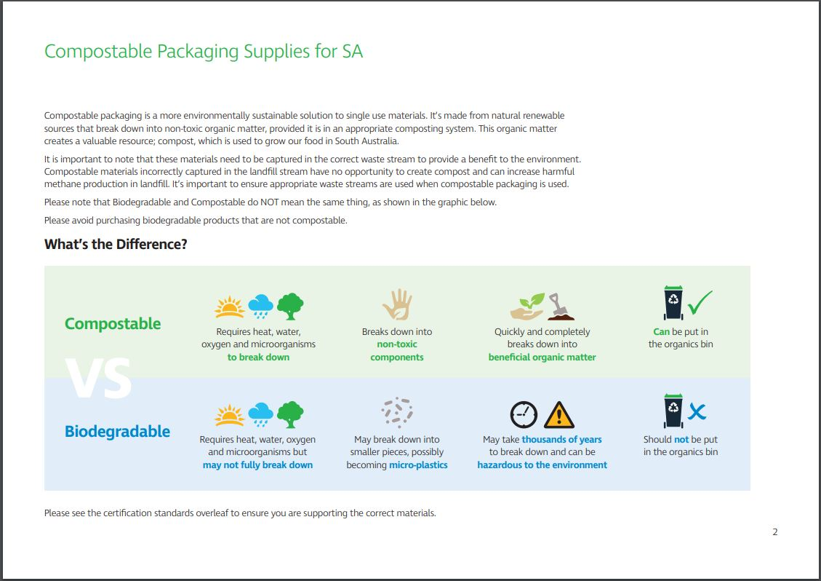
Compostable
Versus
Biodegradable

Slide 4
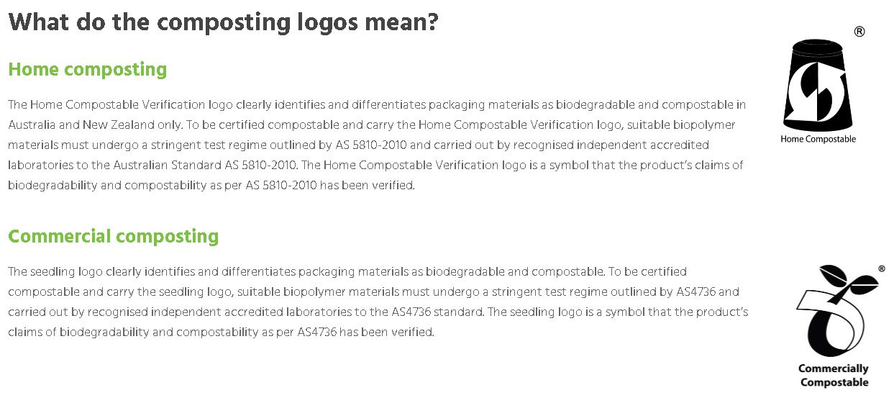
What are Australian compost standards

Slide 5
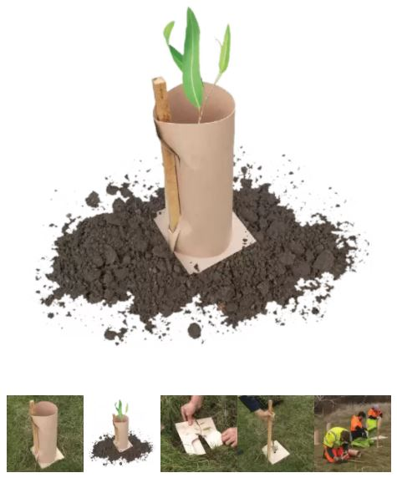
What is currently available
Green-POD – All Stakes Supply
100% recycled fibre
Comes with a weedmat
Requires only one hardwood stake
Difficult for light penetration
Small volume
Difficult to put together

Slide 6
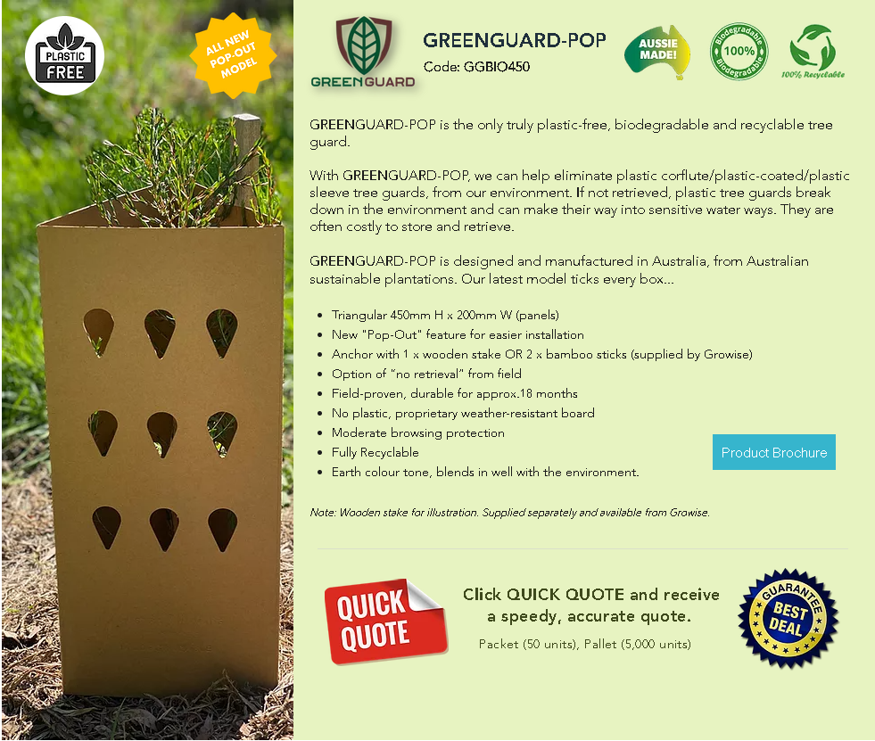
What is currently available
Greenguard Pop – Growise
100% biodegradable
Easy to install
Requires only one hardwood stake
Great light penetration
Material warps and folds when wet
Difficult to spray around

Slide 7
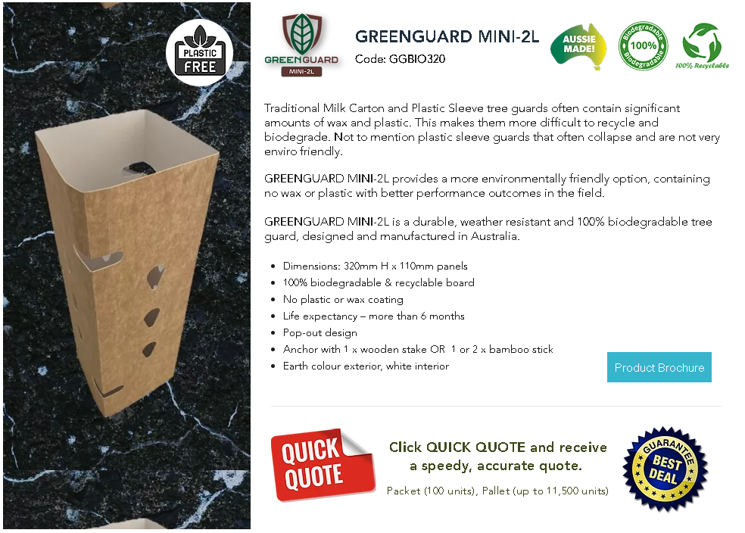
What is currently available
Greenguard Mini – 2L – Growise
100% biodegradable
Easy to install
Great light penetration/white interior
Glue doesn’t hold
Material warps and folds when wet
Breaks down very quickly

Slide 8
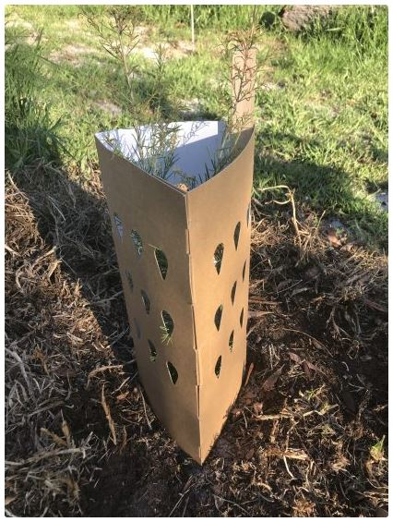
What is currently available
Greenguard – SureGro
100% biodegradable
Great light penetration/white interior
Requires two stakes per guard
Difficult to install
Material warps and folds when wet
Difficult to spray around

Slide 9
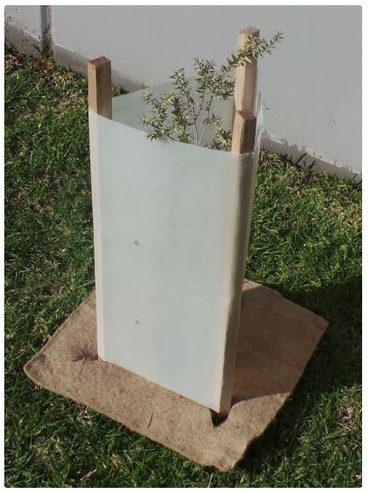
What is currently available
Biodegradable Tree Sleeve – SureGro
100% biodegradable (debateable)
Great light penetration
Has certification for compostability
Difficult to install

Slide 10
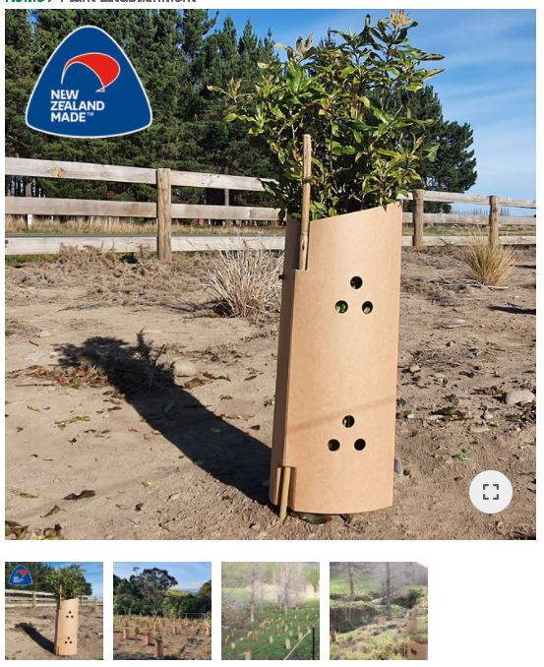
What is currently available
FiberGuard – Advance Landscape Systems
100% biodegradable with durable food safe moisture barrier (what is this?)
Great light penetration
Difficult to install
Cannot spray around

Slide 11
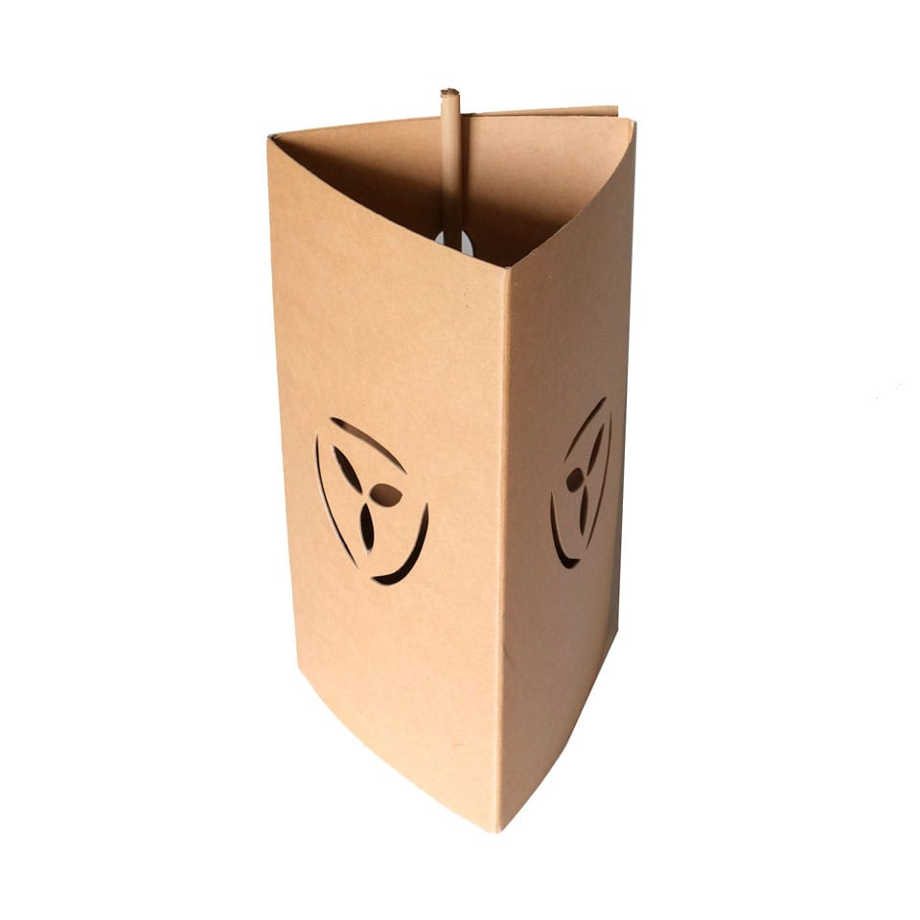
What is currently available
EmGuard – FuturEcology NZ
100% biodegradable with durable food safe moisture barrier (what is this?)
Good light penetration
Easy to install and durable
Can spray around
Councils LOVE them

Slide 12
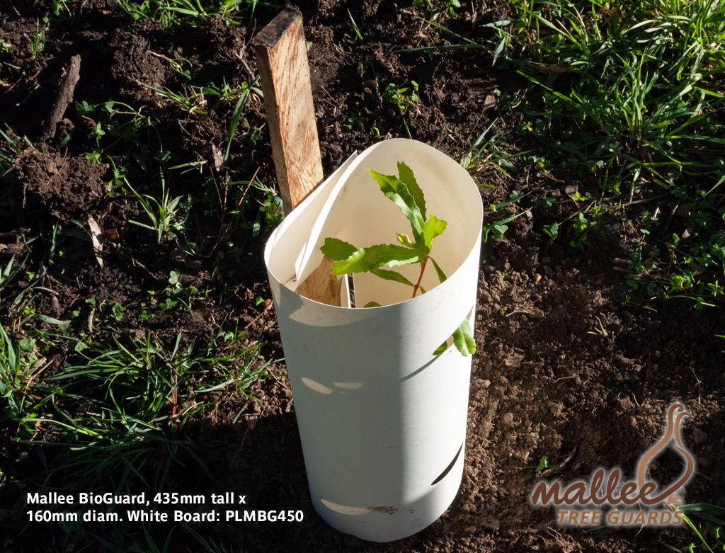
What are we doing?
Biodegradable tube guard – Arborgreen
Due in August 2021
100% biodegradable
Tests show it will survive as long as
the tube-guard
Seeking certification to AS5810

Slide 13
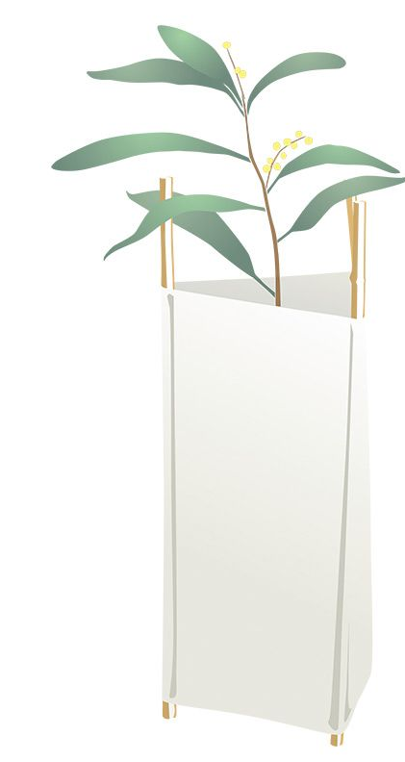
What is currently available
Biodegradable Tree Sleeve – Arborgreen
100% biodegradable (debateable)
Great light penetration
Has certification for compostability
Difficult to install

Slide 14
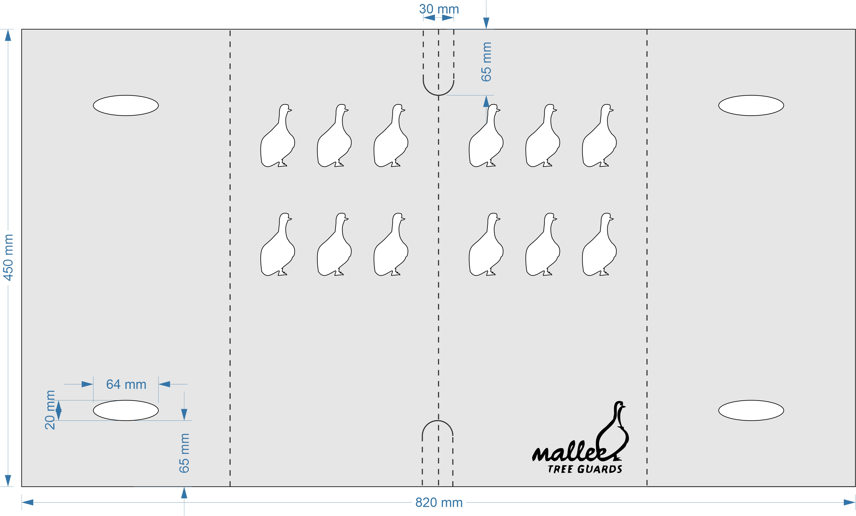
What are we doing?
Biodegradable triangle guard – Arborgreen
PLA laminate over compressed board or laminate board
Trials with Allvirons and NPI being done now

