Slide 1







Erosion Control

Slide 2


What do we supply for erosion control
The products we supply are
800 GSM jute matting rolls (slit and un-slitted)
500 GSM jute mesh bales
400 GSM coir mesh rolls
20 and 30 cm diameter coir logs
Staples and staple guns

Slide 3
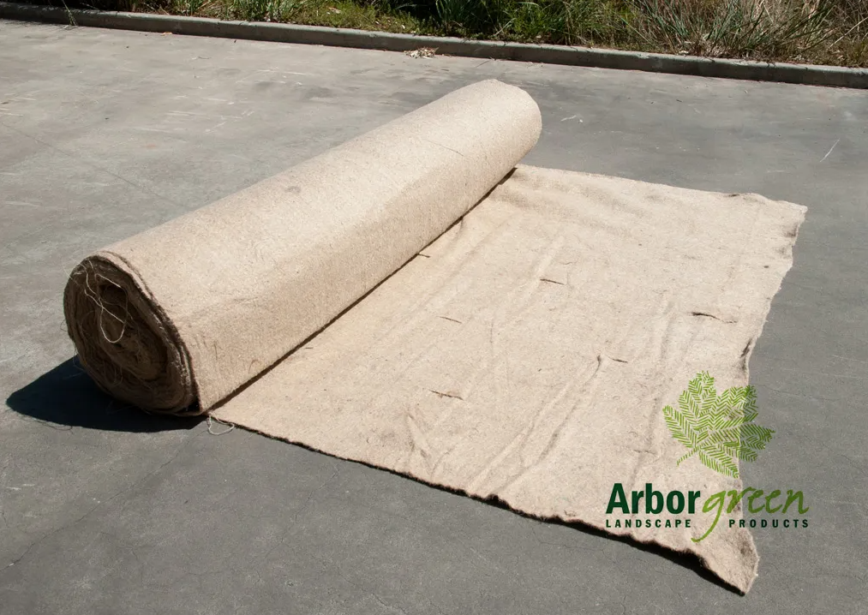
What are they used for
800 GSM Jute matting rolls
Stabilises soil while vegetation establishes
Pre-slitted or easily cut for planting tube-stock
Generally used on slopes 1:3 or flatter
Weed suppression and mulching effect, permits soil to ‘breathe’
Lifespan of 6-18 months depending on application
Pinned at a rate of 4-5 pins/m2

Slide 4
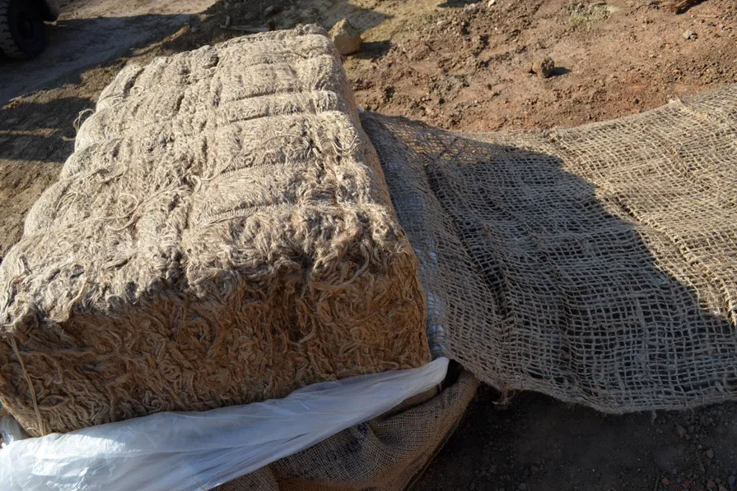
What are they used for
500 GSM Jute mesh bales
Stabilises soil while vegetation establishes
Open weave allows placement over existing small plants
Often direct seeded before laying (particularly with grasses)
Allows germination of existing seedbank (native or weeds)
Lifespan of 6-12 months depending on application
Pinned at a rate of 3-4 pins/m2

Slide 5
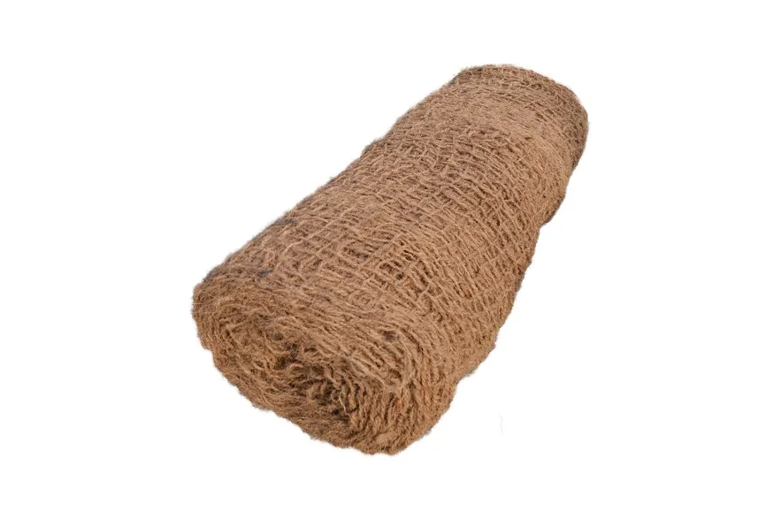
What are they used for
400 GSM Coir mesh rolls
Stabilises soil while vegetation establishes
Open weave allows placement over existing small plants
Often direct seeded before laying (particularly with grasses)
Allows germination of existing seedbank (native or weeds)
Lifespan of 24-36 months depending on application
Pinned at a rate of 3-4 pins/m2

Slide 6
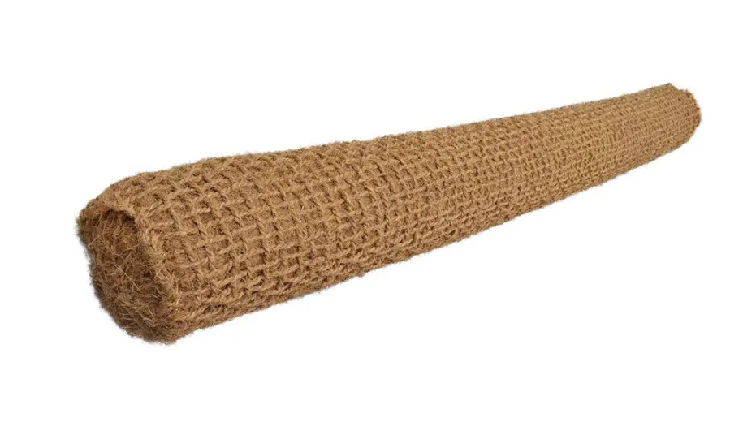
What are they used for
Coir logs
Protects stream banks, stops scouring and soil loss on slopes, sediment traps
Surrounds for street tree planting
Can be planted into, especially along stream banks
Lifespan of 24-60 months depending on application
Staked with hardwood stakes or steel droppers

Slide 7
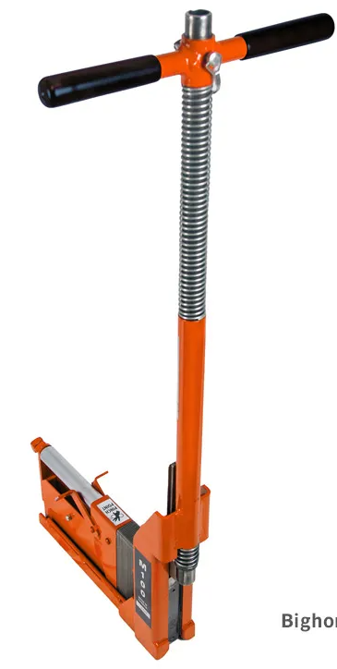
What are they used for
Staples and staple guns
Pin down jute and coir products
Manual or machine installation
Pinning rates vary dependent on slope, product and soil profile
Bighorn gun capable of installing approximately 3,300 pins/hr

Slide 8
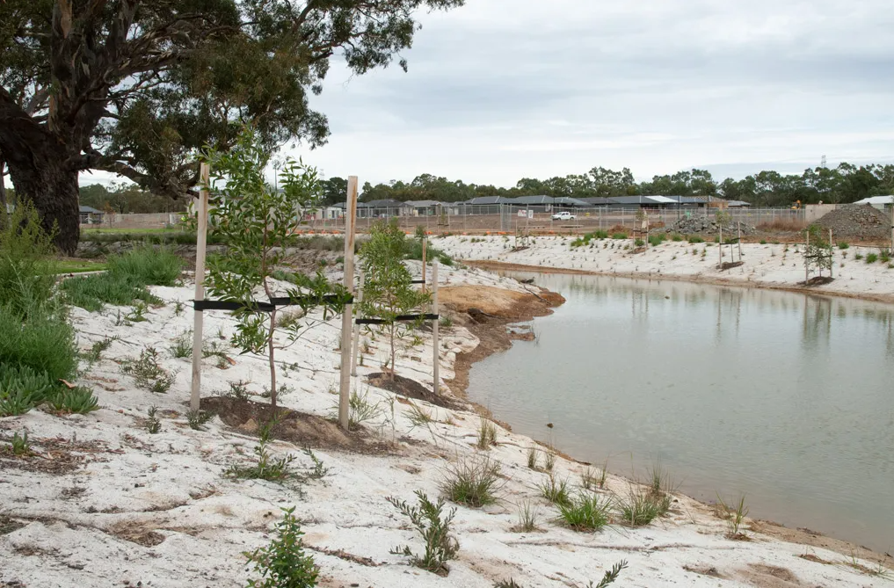
How are they used
800 GSM Jute matting rolls
Shape the site and ensure free of debris, stumps, rocks
Pin and bury upper edge in a 200x200mm trench
Roll mat down slope, perpendicular to water flow direction on slopes and parallel in waterways/swales
Pin matting at required rate (recommend 4-5/m2)
Overlap new rolls by minimum 150mm and bury lower edge

Slide 9
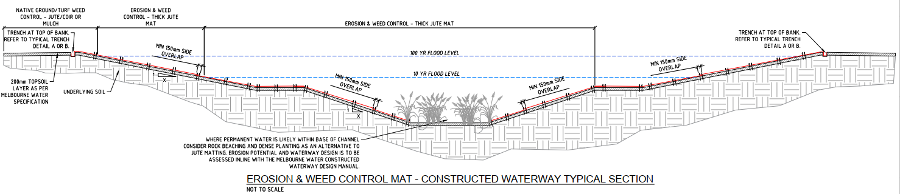
Example drawings

Slide 10
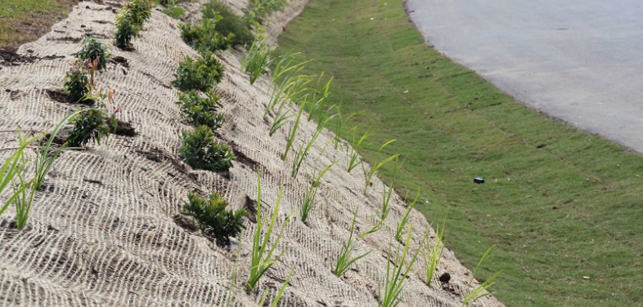
How are they used
500 GSM Jute mesh bales and 400 GSM Coir mesh rolls
Shape the site and ensure free of debris, stumps, rocks
Complete any seeding required.
Pin and bury upper edge in a 200x200mm trench
Roll mat down slope, perpendicular to water flow direction on slopes and parallel in waterways/swales
Pin matting at required rate (recommend 3-4/m2)
Overlap new rolls by minimum 150mm and bury lower edge

Slide 11
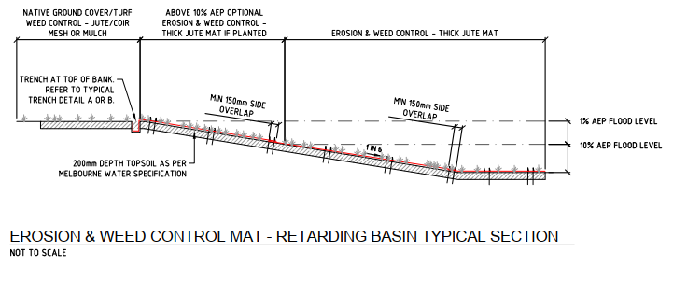
Example drawings

Slide 12
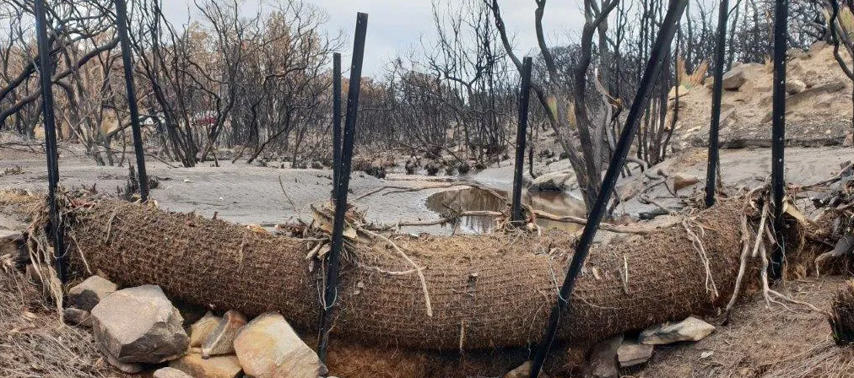
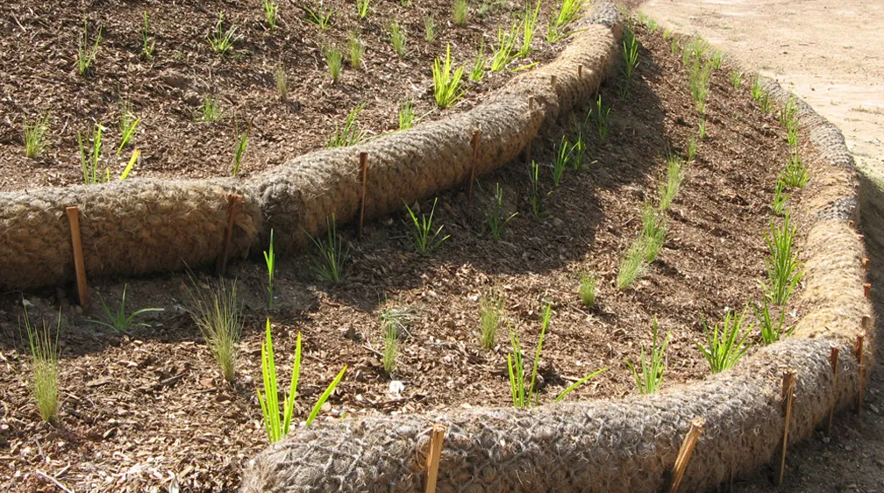
How are they used
Coir logs
Shape the site and ensure free of debris, stumps, rocks and install erosion matting as required
Excavate trench for logs parallel to water edge or perpendicular to water flow, recessing 1/3 of log into bank
Place logs end to end, with final ends rotated up bank
Install stakes either side of logs with max distance of 1m between stakes and 300mm to end of log
Tie logs to stakes by interlacing rope or twine and backfill behind logs

Slide 13
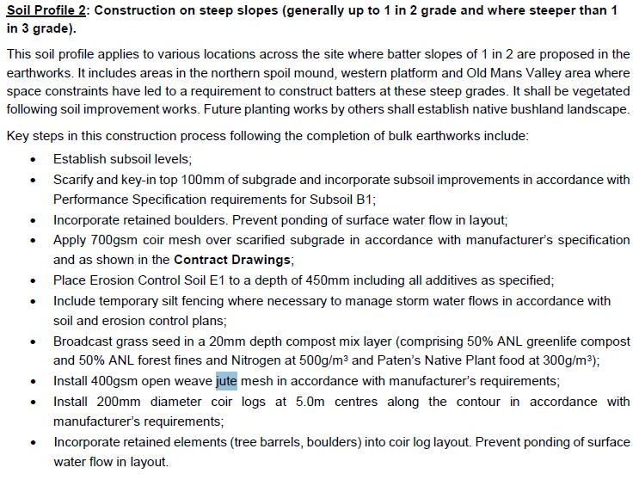
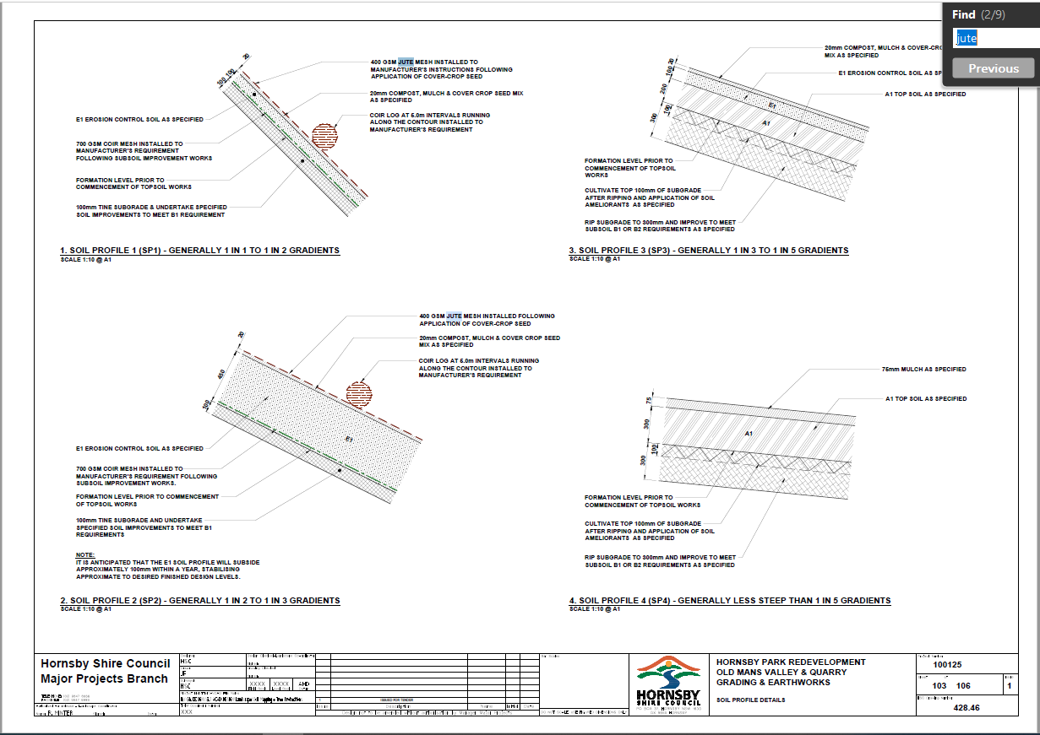
Combined installation example

Slide 14
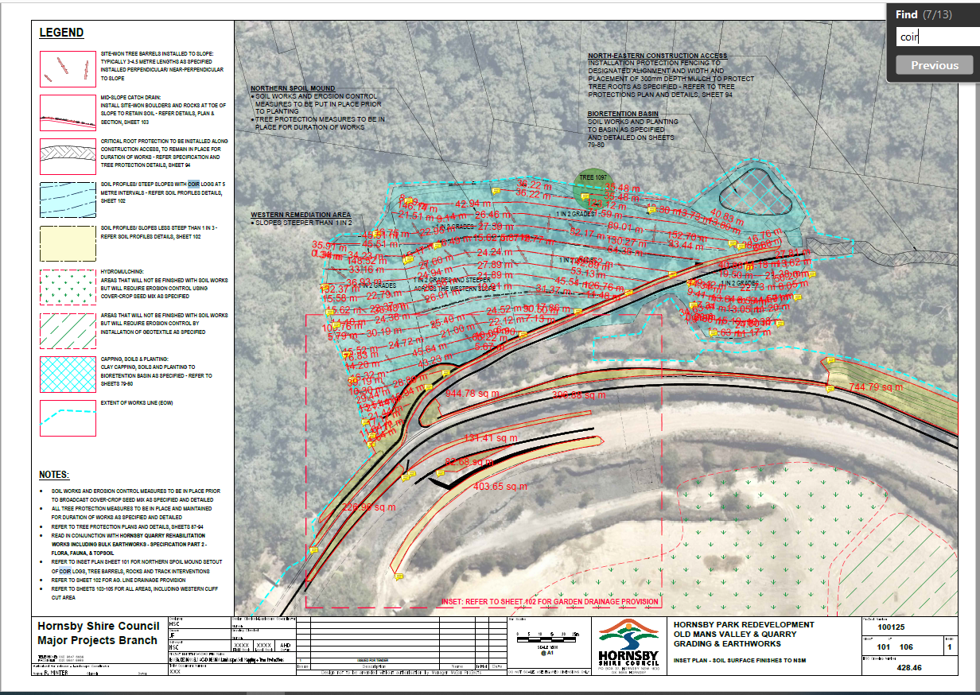
Example plan

