Slide 1








Fertilisers

Slide 2
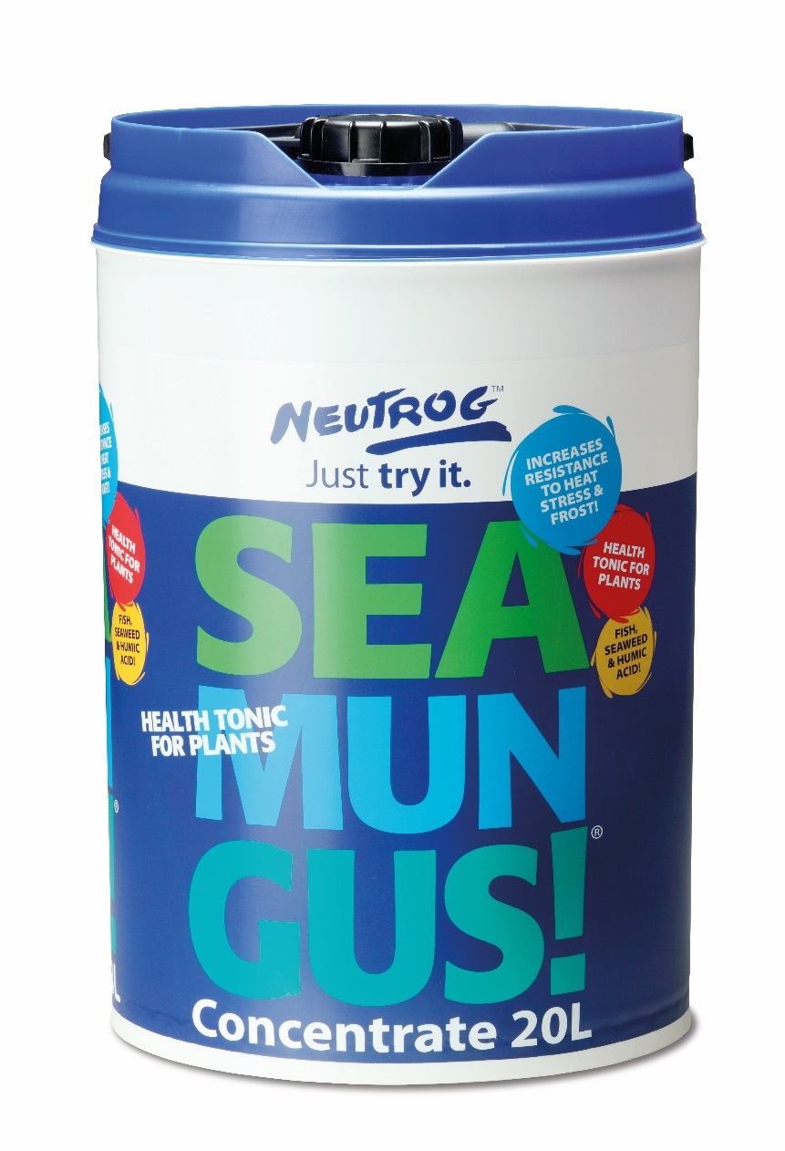
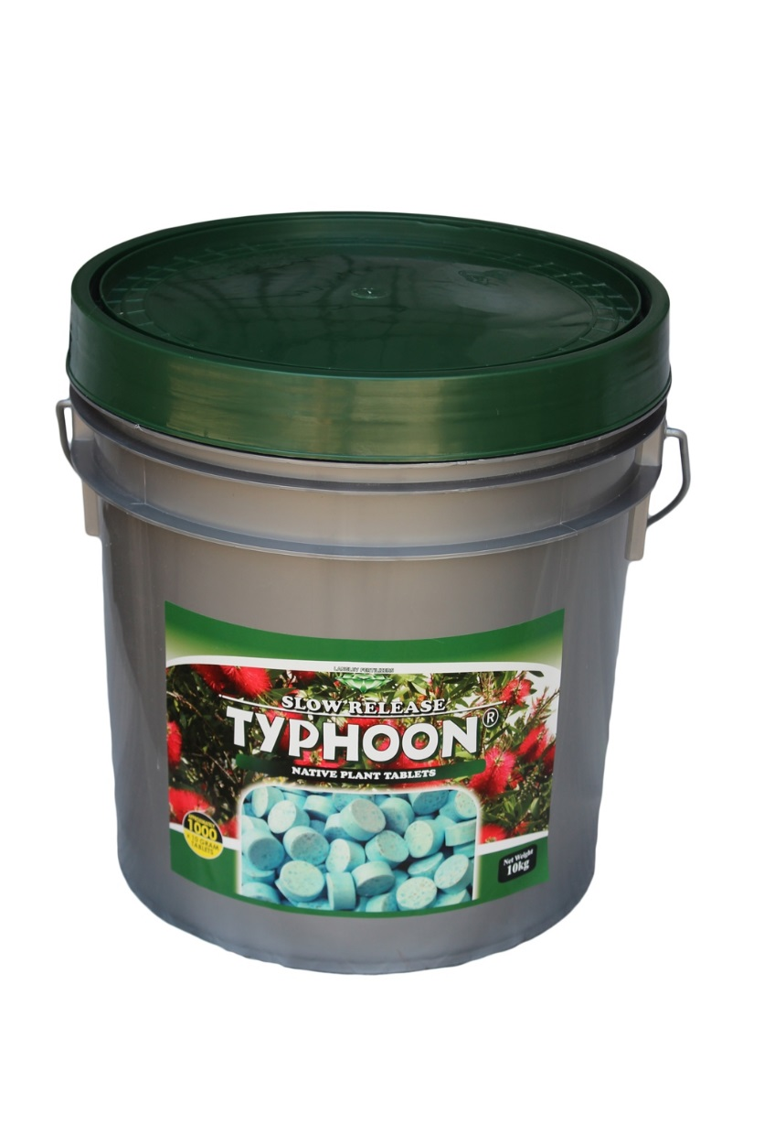
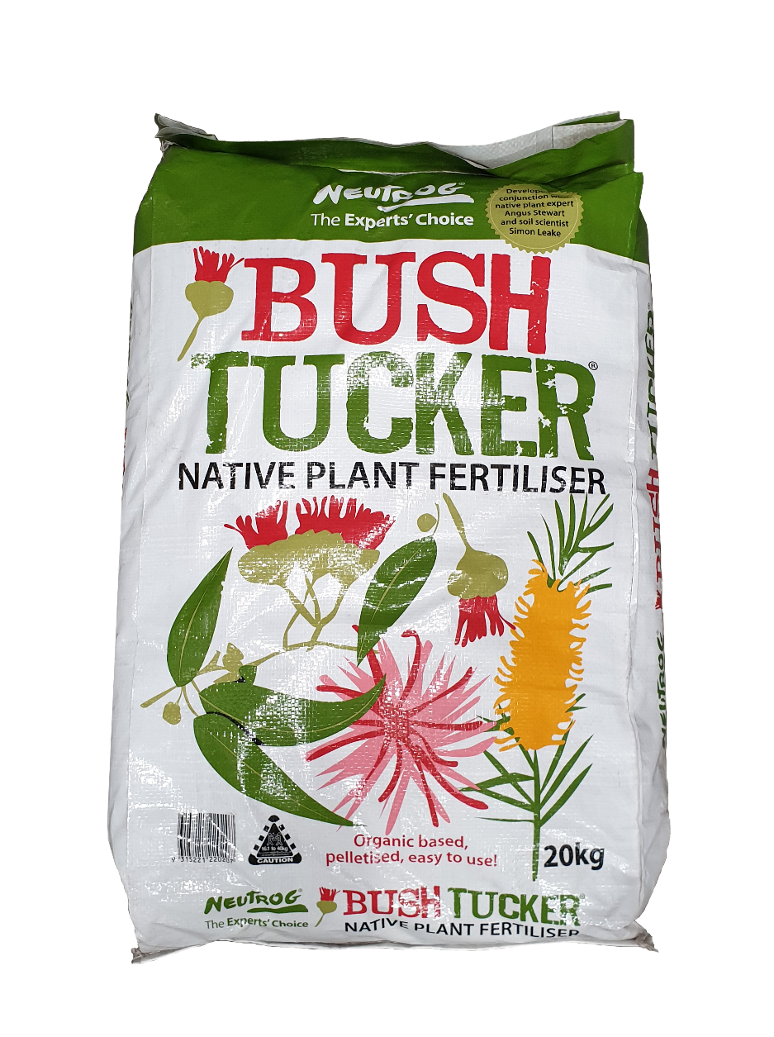


Fertilisers

Slide 3
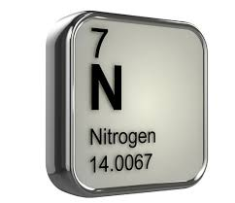
Nitrogen
What does it do?
Promotes leaf growth and gives plants their green colour (iron also plays a large role in leaf colour)
Plays a critical part of photosynthesis
Too much on its own can be a bad thing, as it makes lots of new sappy growth that isn’t strong
Legume plants take nitrogen from the air and fix it in the soil

Slide 4
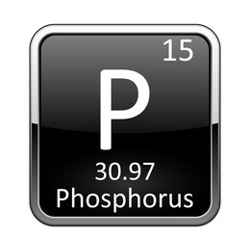
Phosphorous
What does it do?
Promotes root growth
Essential for cell division and energy transfer
Australian soils often have low phosphorous levels
Native plants have adapted to low levels and can suffer from high-phosphorous fertilisers

Slide 5
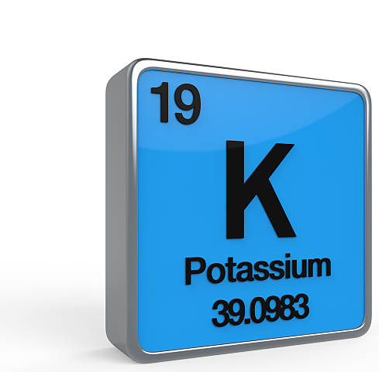
Potassium
What does it do?
Encourages flowering
Sweetens fruit
Strengthens plants (Fruit trees benefit from higher potassium fertilisers in winter)
Helps prevent diseases by thickening cell walls

Slide 6

Soil Wetters
What do they do?
Reduces water surface tension
Allows water to penetrate further into the soil, encouraging deeper roots and healthier plants
Increases water efficiency by reducing run-off
Great for hydro-phobic soils!

Slide 7
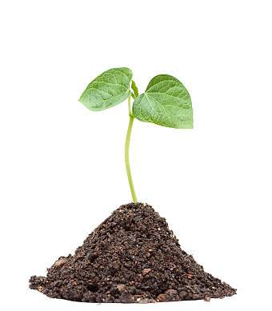
Water Retention
What do they do?
Absorb and retain soil moisture
Allow plants to access water over time
Increases water efficiency by reducing watering requirements
Great for reducing transplant shock

Slide 8
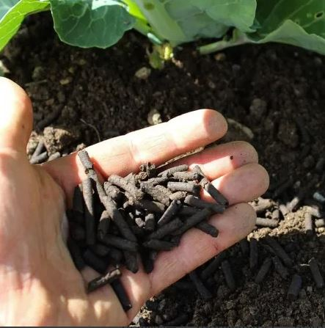
Form
How are they supplied?
LIQUIDS – quick uptake by the plant, able to be taken up by plant roots and foliage, useful for fast correction of nutrient deficiencies, able to be mixed and applied with water
SOLIDS – slower, long term release of nutrients, taken up by plant roots, available as tablets, in granular form, as pellets, as mini-prills, simple to apply

Slide 9
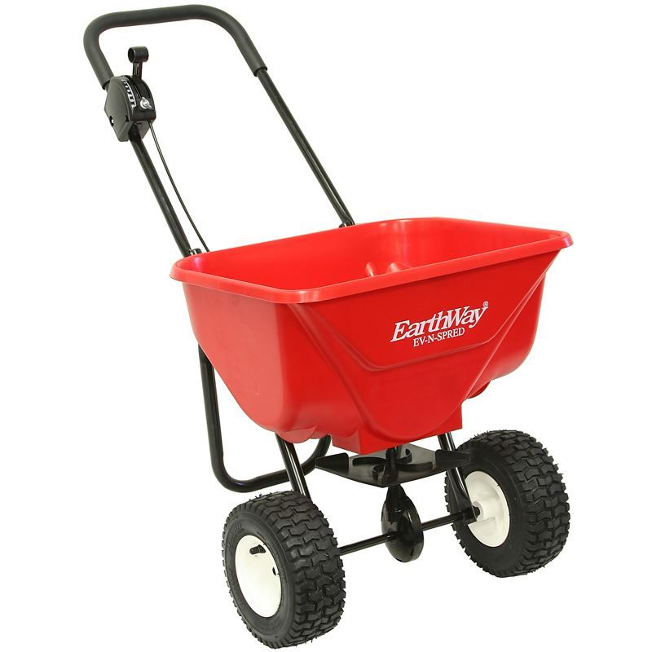
Application
How do I apply them?
SPREAD WITH WALK BEHIND OR HANDHELD SPREADER
APPLIED AS SOIL DRENCH
MIXED WITH SOIL AT PLANTING
SPRAYED ONTO FOLIAGE
INSERTED INTO GROUND AS A TABLET

Slide 10

Timing
When do I apply them?
AT PLANTING – consider purpose, soil type, project specifications, species, planned watering regime
DURING GROWING PERIOD – to encourage fruit development, leaf growth, root strength, plant health
DURING DORMANCY – consider time to work into the soil so it’s available for growing period, strengthen plant for spring growth
ONCE OFF/ONGOING

Slide 11
Top 5 Fertilisers in 2020
WEBSTORE SALES
Terra Start 10kg tub
Typhoon 10g Native fertilizer tablets (closely followed by 20g tablets)
Neutrog Bush Tucker 20kg bag
Seasol + Powerfeed 20L drum
Seasol Water Crystals 25kg bag

Slide 12
Top 5 Fertilisers FY to date
TOTAL EXO SALES
Seamungus 20kg bag
Seamungus 20L concentrate drum
GOGO Juice 20L drum
Macracote Grey 20kg bag
Blade Runner 20kg bag

Slide 13
Additional notes
Other points to discuss
Sudden Impact for Roses – Mitre 10 example (Richard)
Bailey’s Terra Start – we have distribution rights for whole Eastern Seaboard
GOGO Juice – micro biology, not so much a fertilizer as a tonic
https://localfoodconnect.org.au/community-gardening/fruit-tree-fertilising-schedule/

