Slide 1


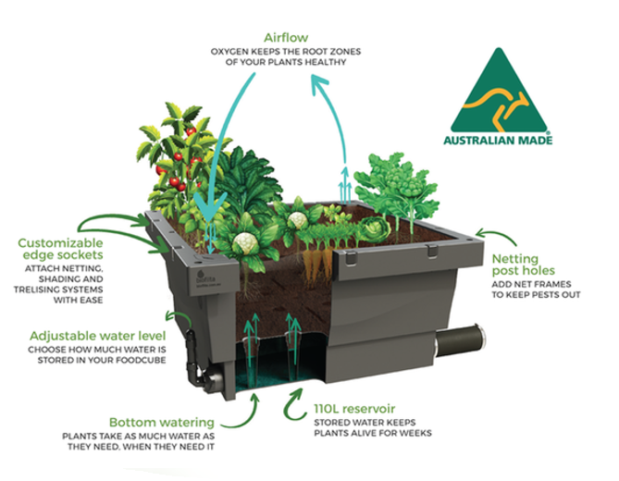






Foodcube

Slide 2
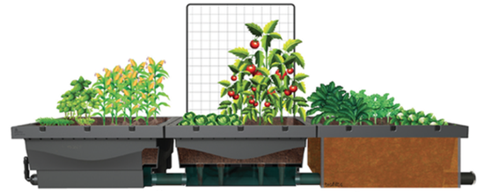


What is a Foodcube?
The foodcube is a revolutionary new planter, which features an inbuilt 110 litre reservoir and a 90mm connection point used to attach multiple cubes together.
The foodcubes are made in Melbourne from UV stabilized recycled plastic and are becoming increasingly popular in the market place thanks to the many benefits that they have.

Slide 3
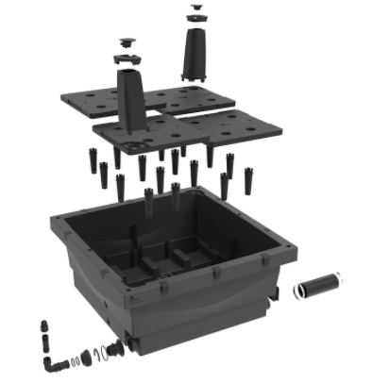
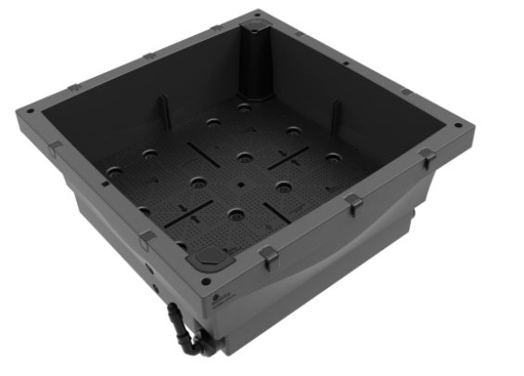
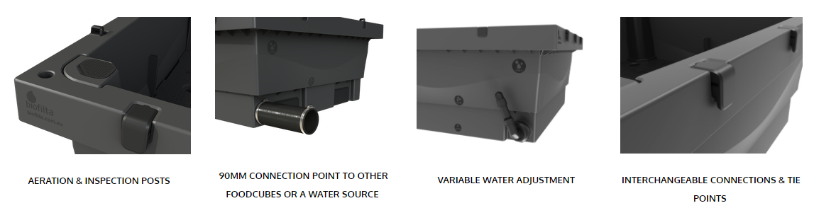
How do they work?

Slide 4




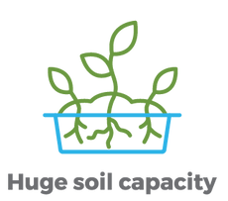

Key Benefits of the cubes?
Large 1150mm x 1150mm x 500mm
Provides 1m2 of growing area
Made from recycled material
Modular system allows easy connection
Fully sealed, advanced wicking design
Low water use
Low cost per m2
Moveable via pallet jack or fork lift
Designed to add netting and cover systems
Self-aerating
Add different facades or aesthetic features to suit

Slide 5
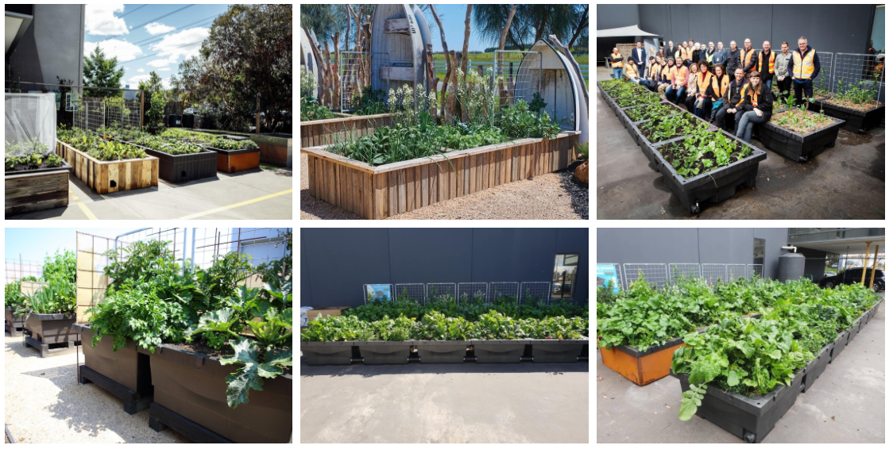
Attachments and Accessories

