Slide 1







Fruit Picking

Slide 2
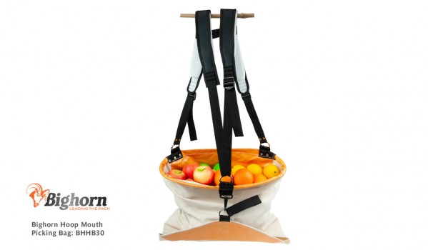


Hoop Mouth Picking Bags
Top of bag held open by steel hoop
Only one size 33L one bushel
Ideal for most fruits to reduce bruising
Bruising is an issue for export not so much for juice fruits
Not suitable for climbing on ladders due to safety risks

Slide 3
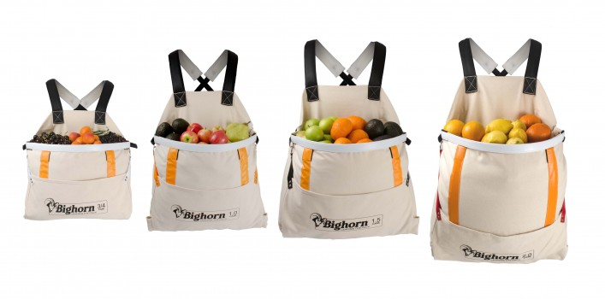
Open Mouth picking bags
Multiple sizes
Too many uses to list
Release fruit from the bottom
More safe to use on ladders
Code | Case Capacity | Litres | Strap Colour
BHOFB34 | 3/4 | 26L | White
BHOFB10 | 1 | 36L | Orange
BHOFB15 | 1.5 | 50L | Black
BHOFB20 | 2 | 70L | Red

Slide 4
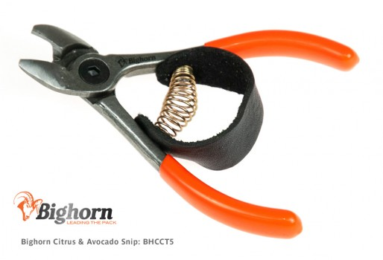
Citrus picking snips
Is an anvil cutter rather than bypass for tougher stalks such as avocadoes
Primarily used after a cut and hold pruner to remove the fruit from the tree then snip stalk after the fact

Slide 5
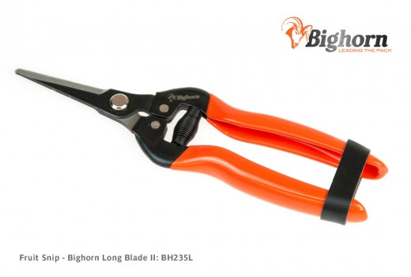
Long blade fruit snips
Mainly used for table grapes as the longer reach enables to picker to get into tricky areas of vine
300l High carbon used where dry
SE45 used in wetter areas as the are made of Stainless steel

Slide 6
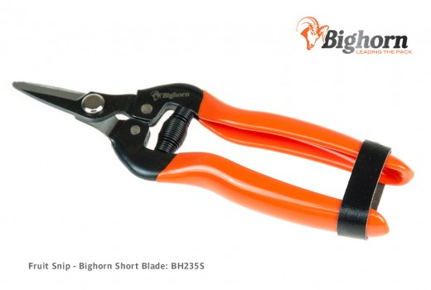
Short blade fruit snips
Also for mainly wine grapes
Uses for other soft fruits to reduce collateral damager from overreaching blades

Slide 7
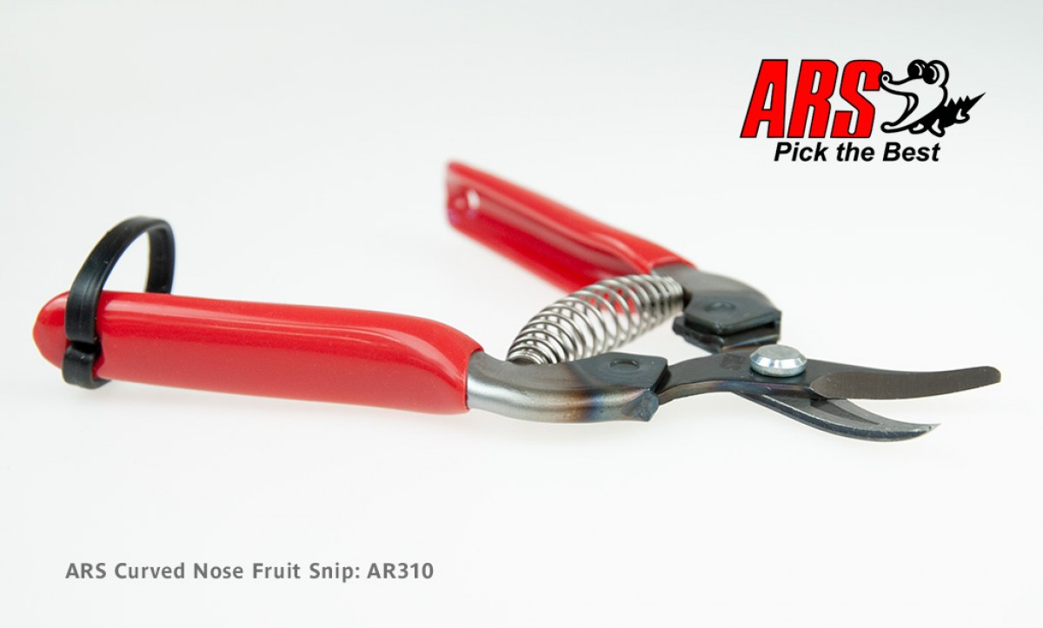
Curved blade fruit snips
Mainly for mandarins because of the shape of the blade can get close to the fruit
2 different levels of curve hardly noticeable

