Slide 1
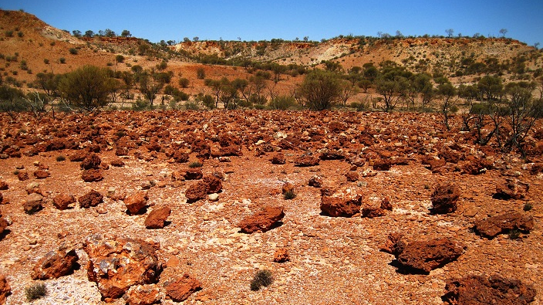

Slide 2
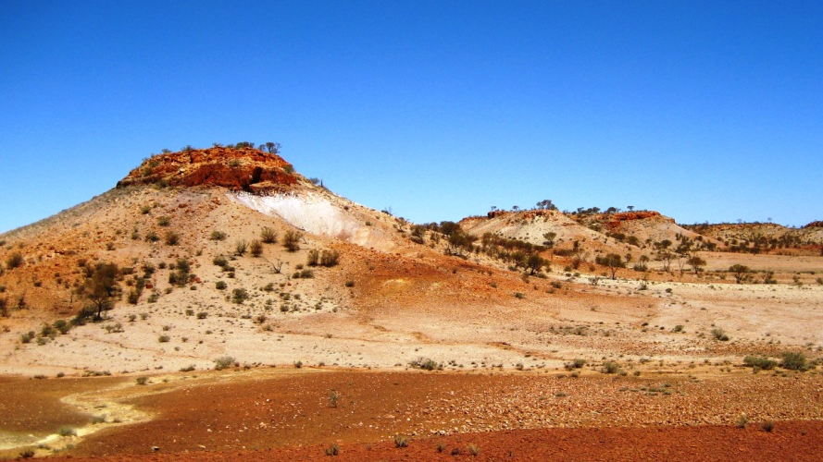

Slide 3
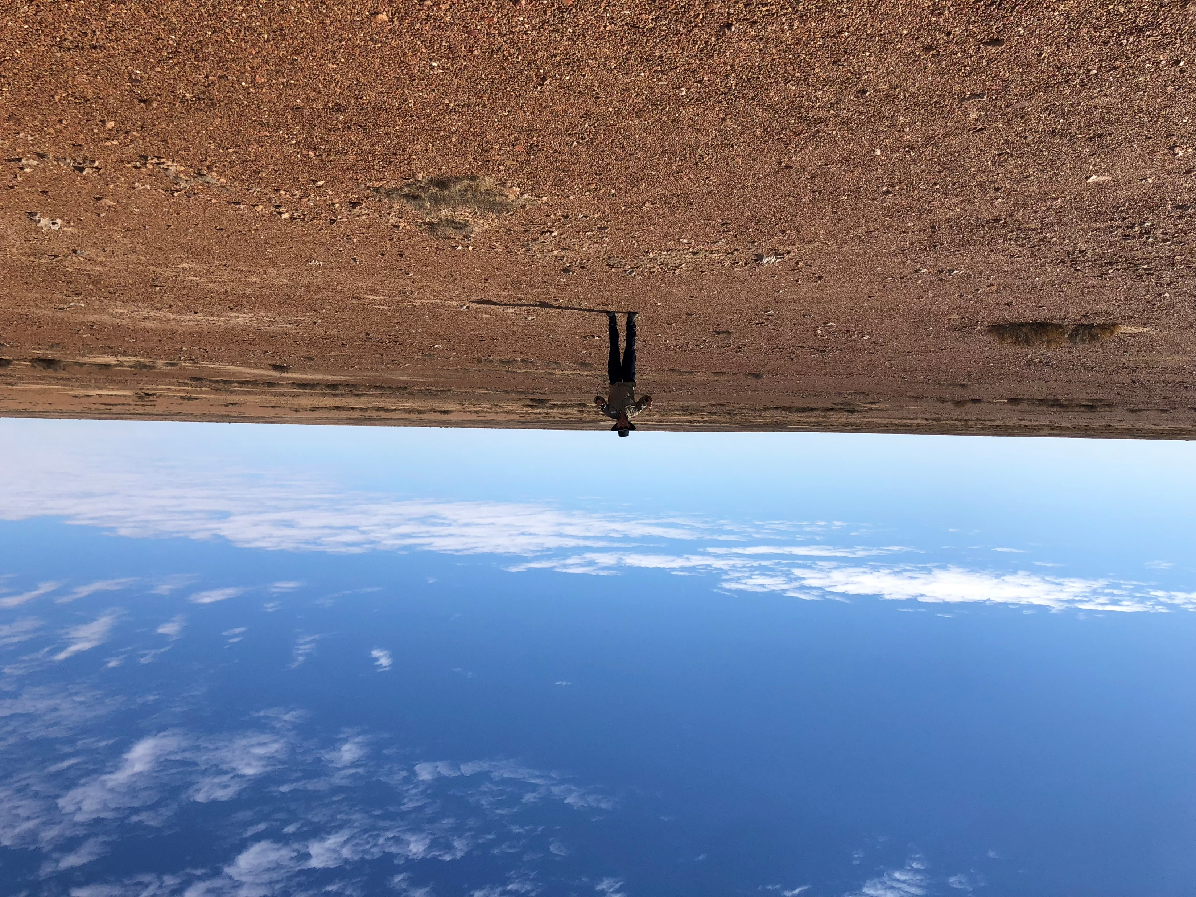

Slide 4
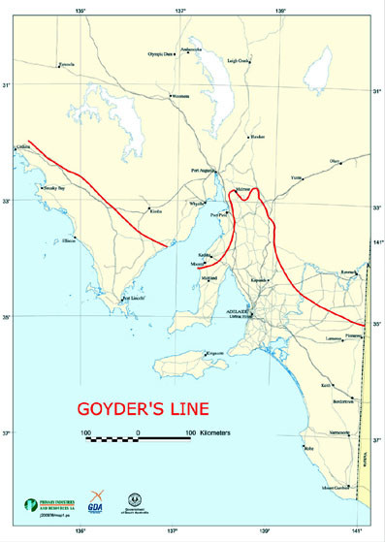
Goyder’s Line benchmarked ~250mm/yr….
….but is 300 or 350mm/yr more appropriate to define the Arid zone (for reveg)?
Aspect, soil type & depth, site history and condition can also be factors

Slide 5
• What are some of the unique challenges these sites present?
  ­ Aridity!!! :P ….
    ­ Grazing Pressure
    Lack of rain
    ­ Lack of soil – due to overgrazing & soil damage
    ­ Intense & or prolonged heat
    ­ Potentially frost &/or intense rainfall/erosion
    ­ Wind blasting
    ­ Weeds…not so much – compared to non-arid, but…
    ­ Fire…not so much – compared to non-arid, but…

Slide 6
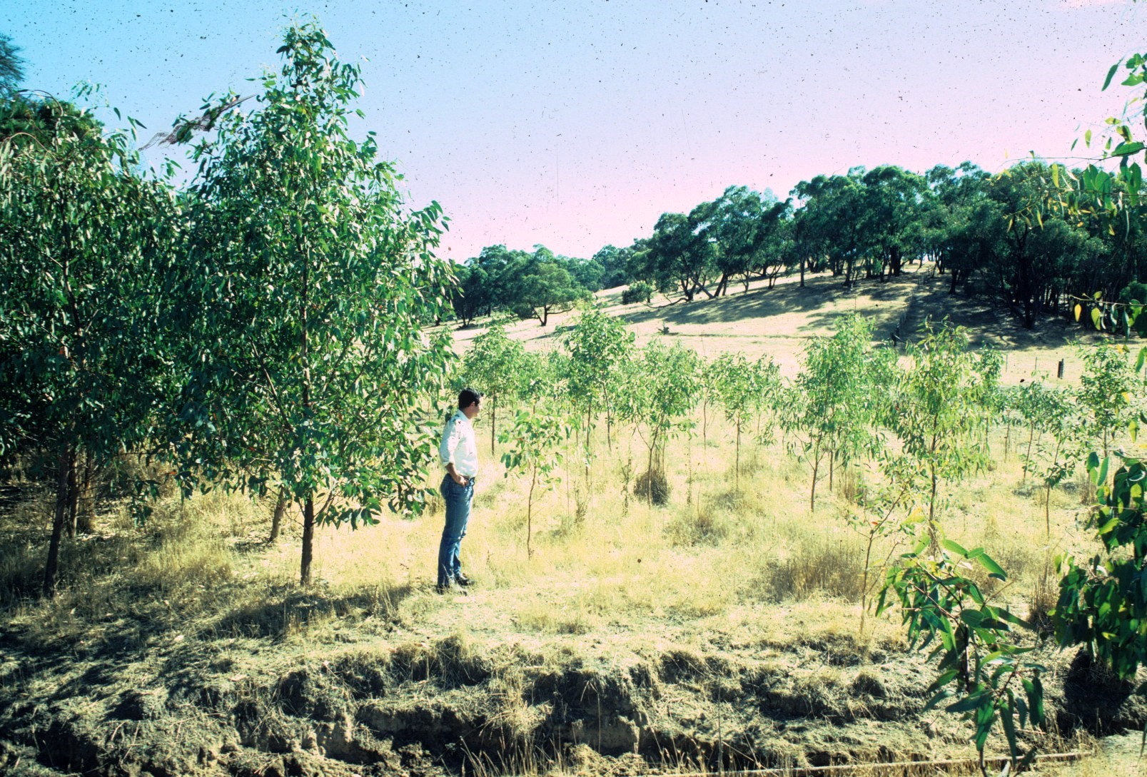
Weed Control!

Slide 7
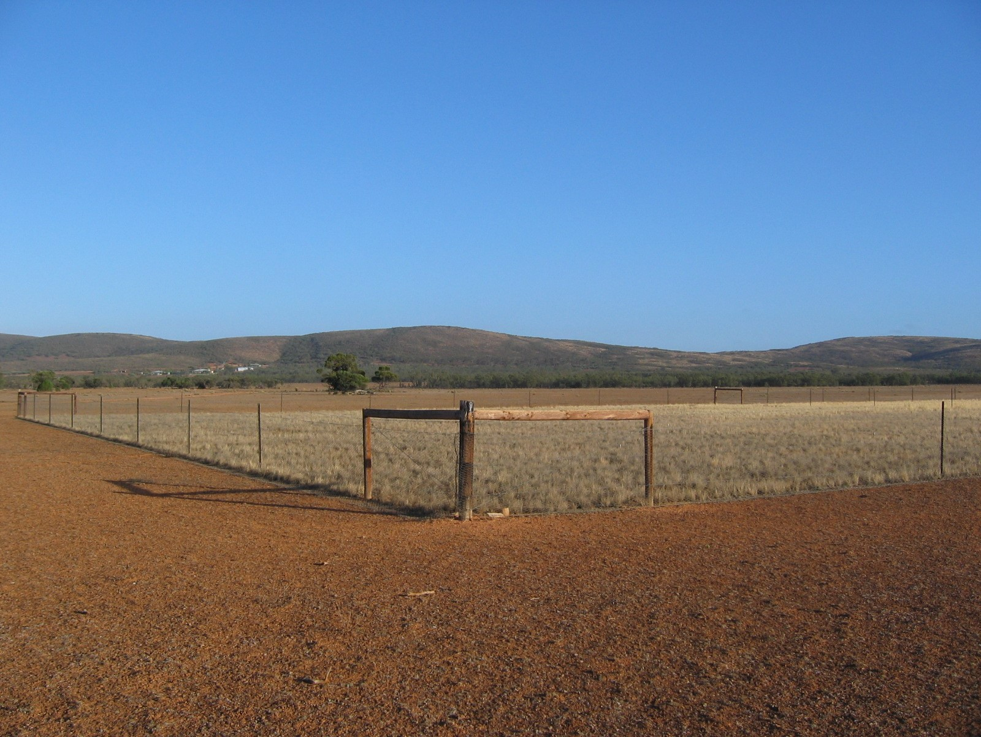
What can I do?
....do the basics 1^{st......}
Grazing pressure ......

Slide 8
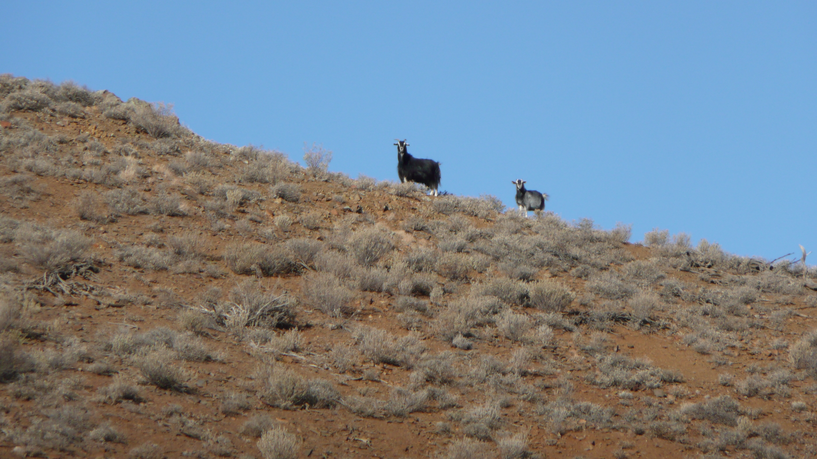

Slide 9
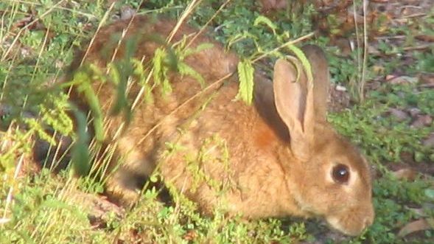

Slide 10
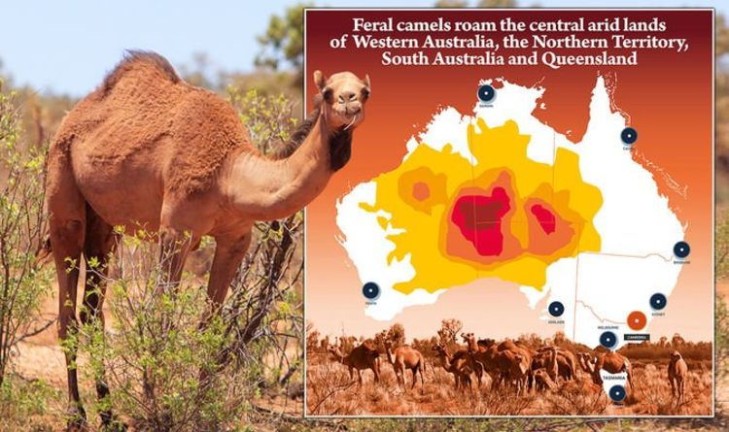

Slide 11
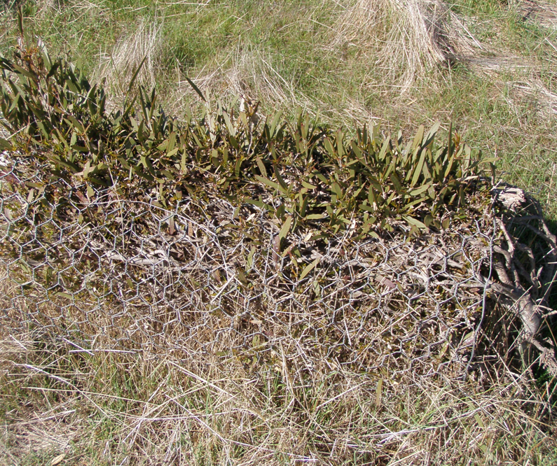
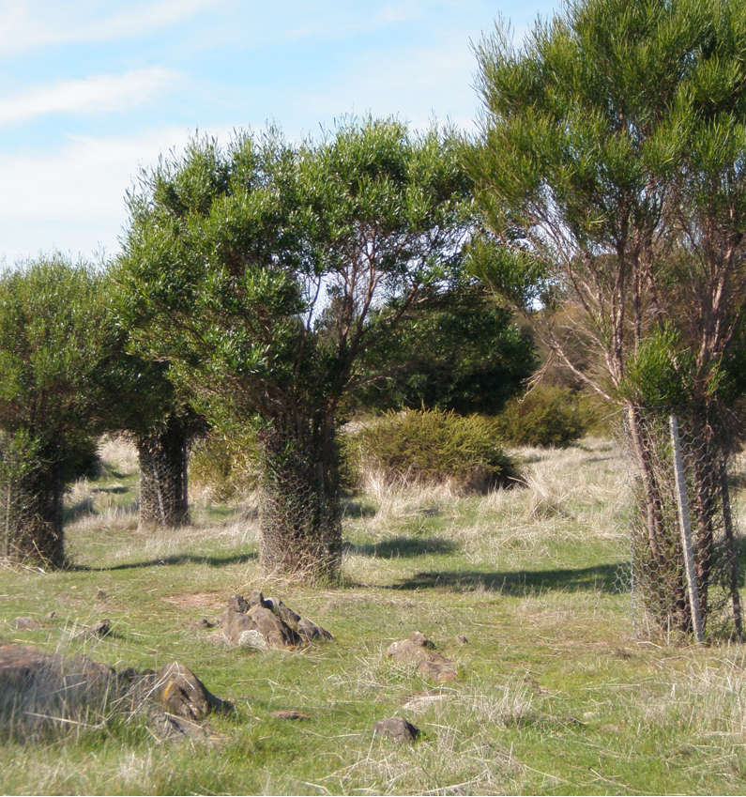

Slide 12
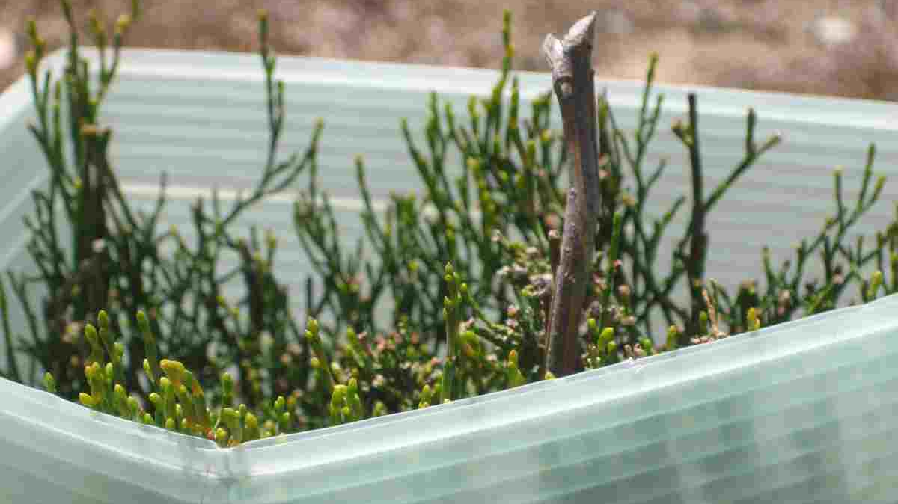

Slide 13
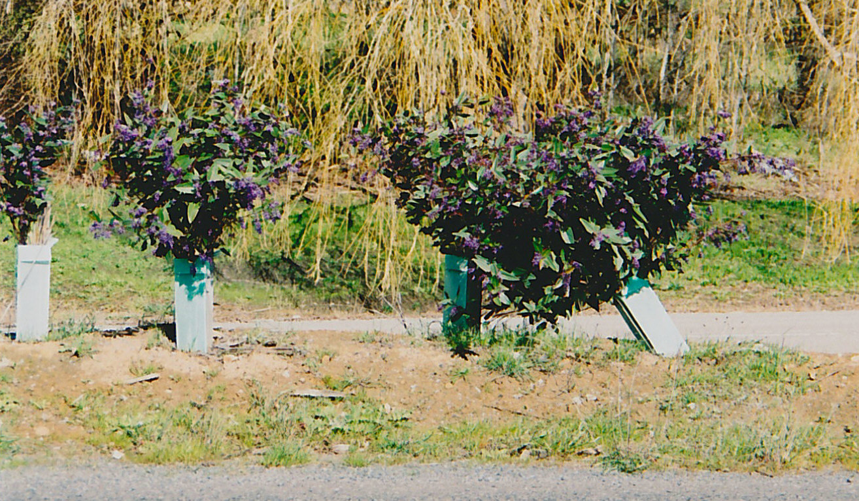

Slide 14
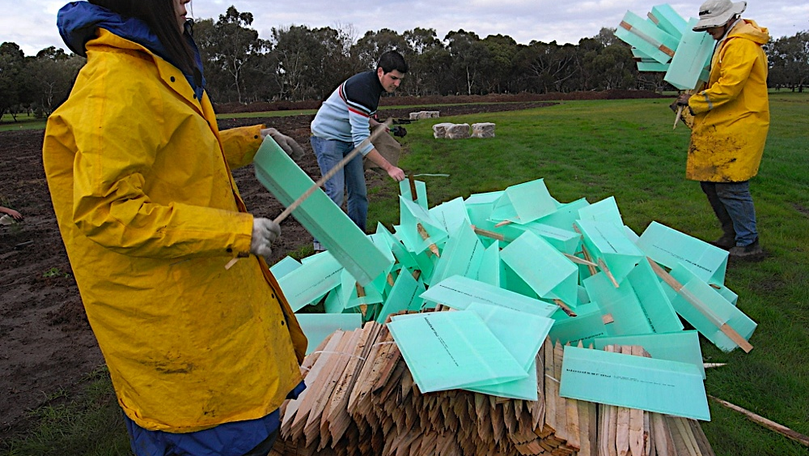

Slide 15
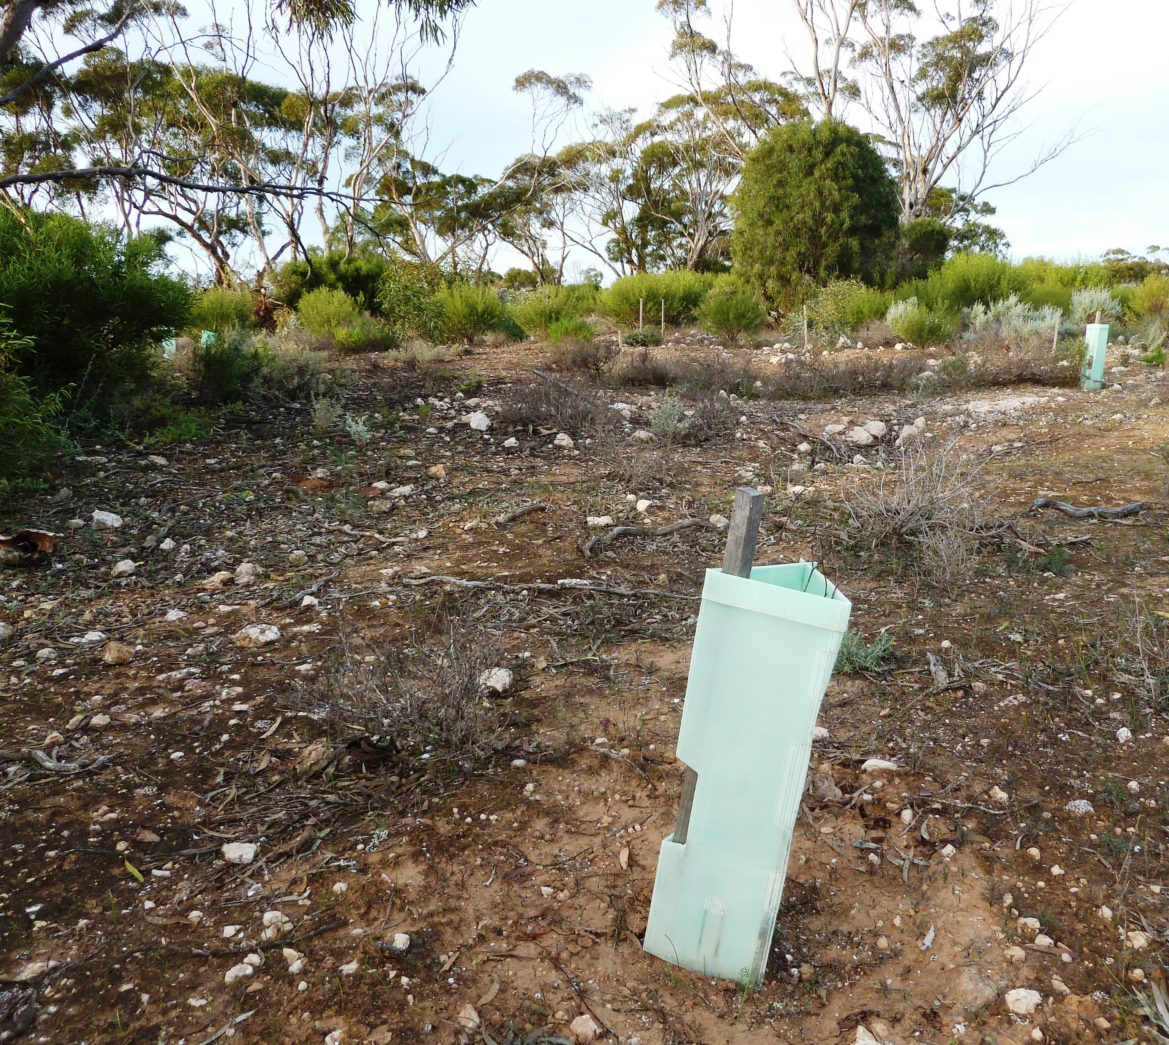

Slide 16
• What are best practices for revegetation in these areas?
  ­ Exploit natural regeneration.
    ­ Time.
    ­ Fencing (don’t rely on treeguards).
  ­Incorporate direct seeding (with appropriate species – groundcovers: low saltbushes and native grasses).
  Appropriate species selection, timing, planting methods and site preparation.
  Perforated* (compostable*) treeguards.
  ­ Mulch* (care with colour, proximity and content).
  ­ Soil wetters, if appropriate.
  ­ Rainfall harvesting with supplementary watering.
  ­ Beware of fertilisers and water crystals.

Slide 17
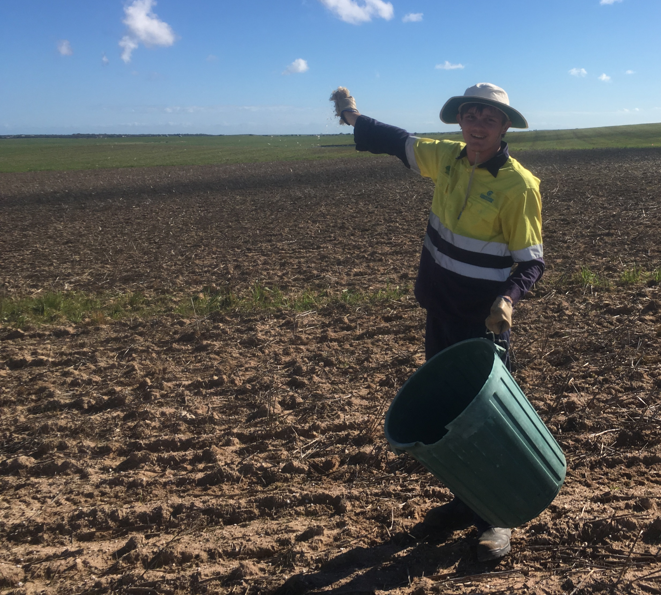
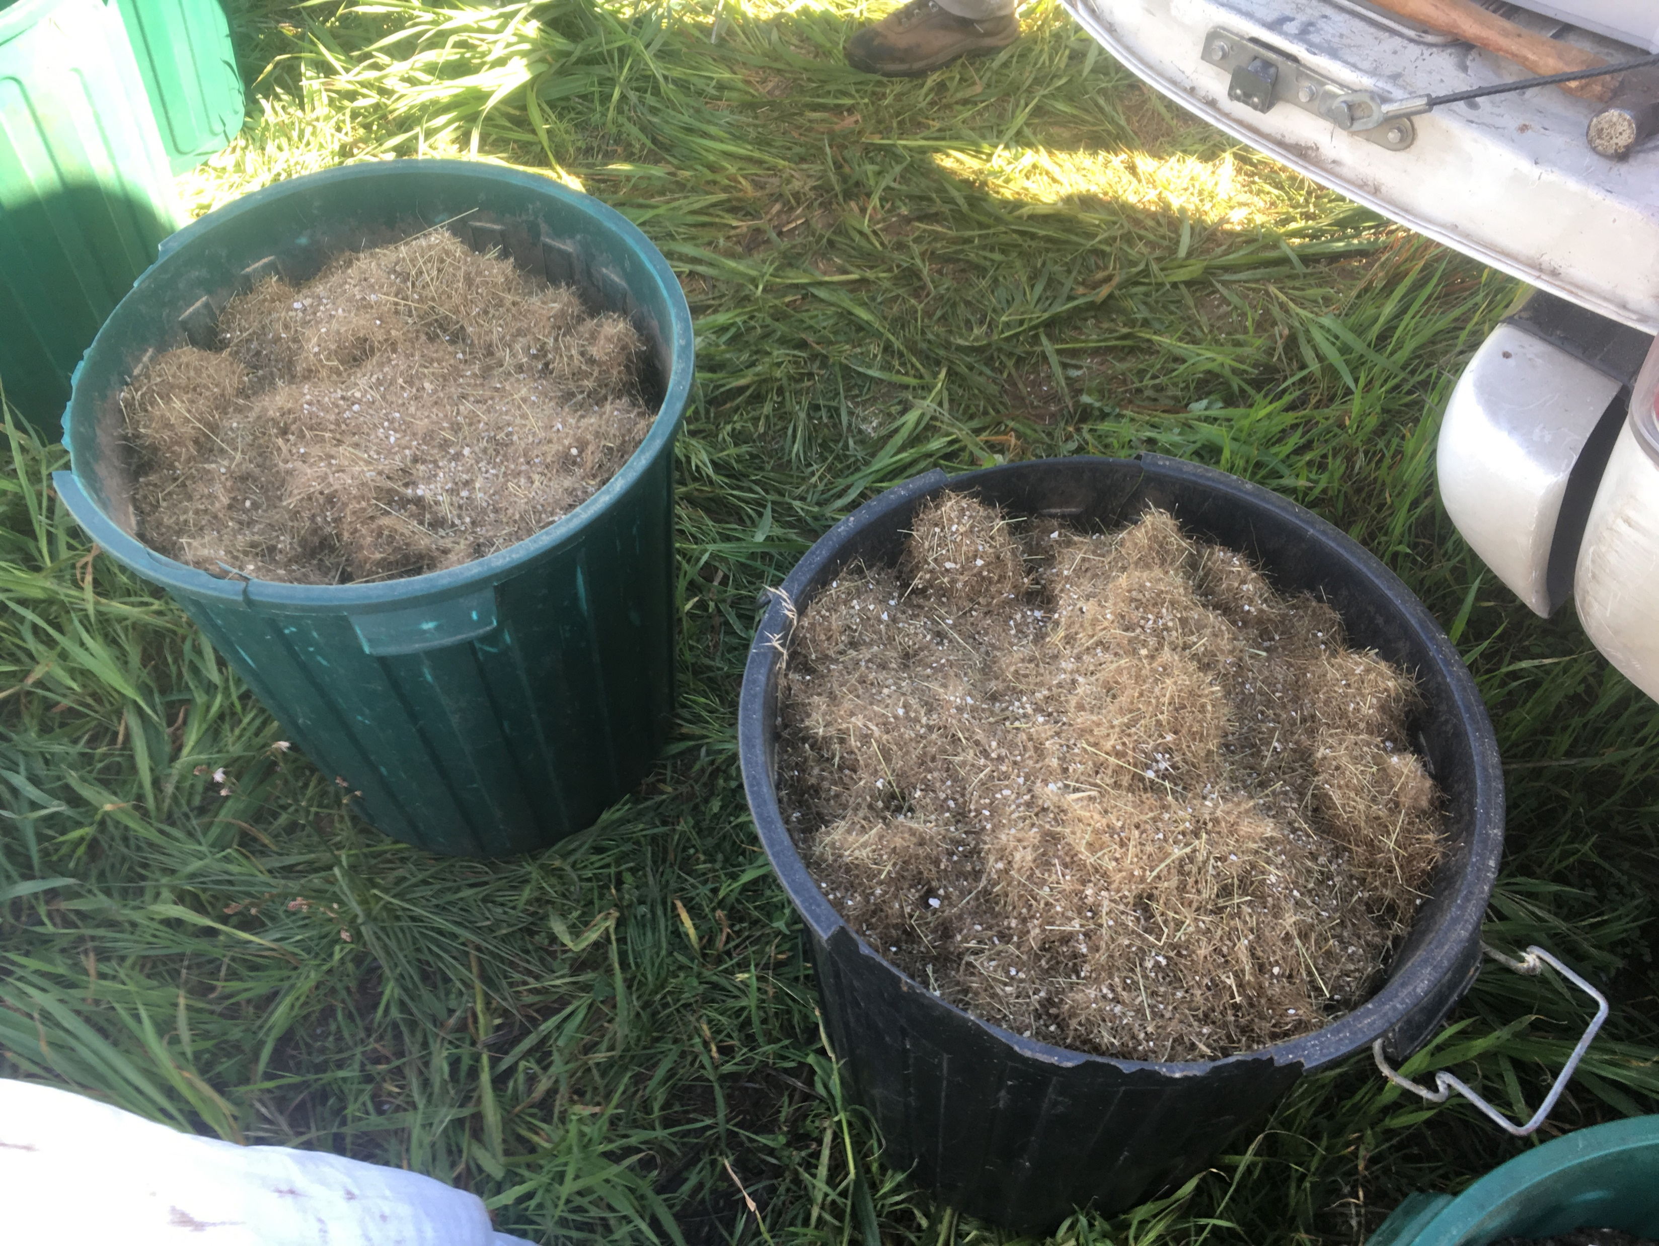

Slide 18
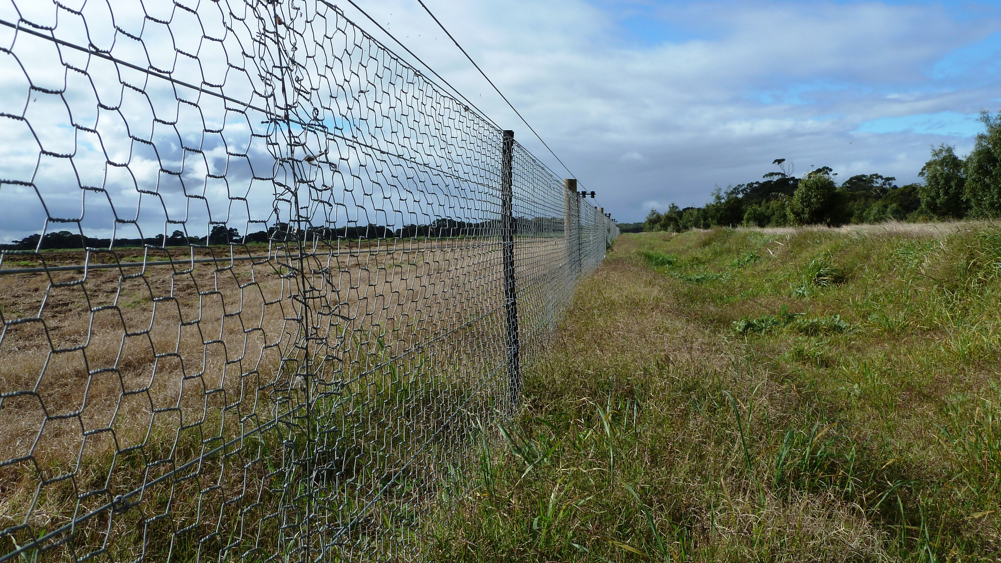

Slide 19
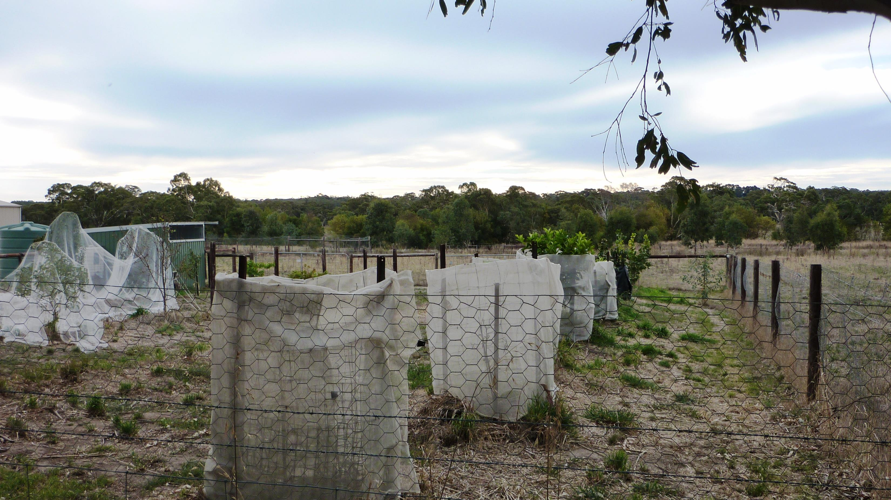

Slide 20
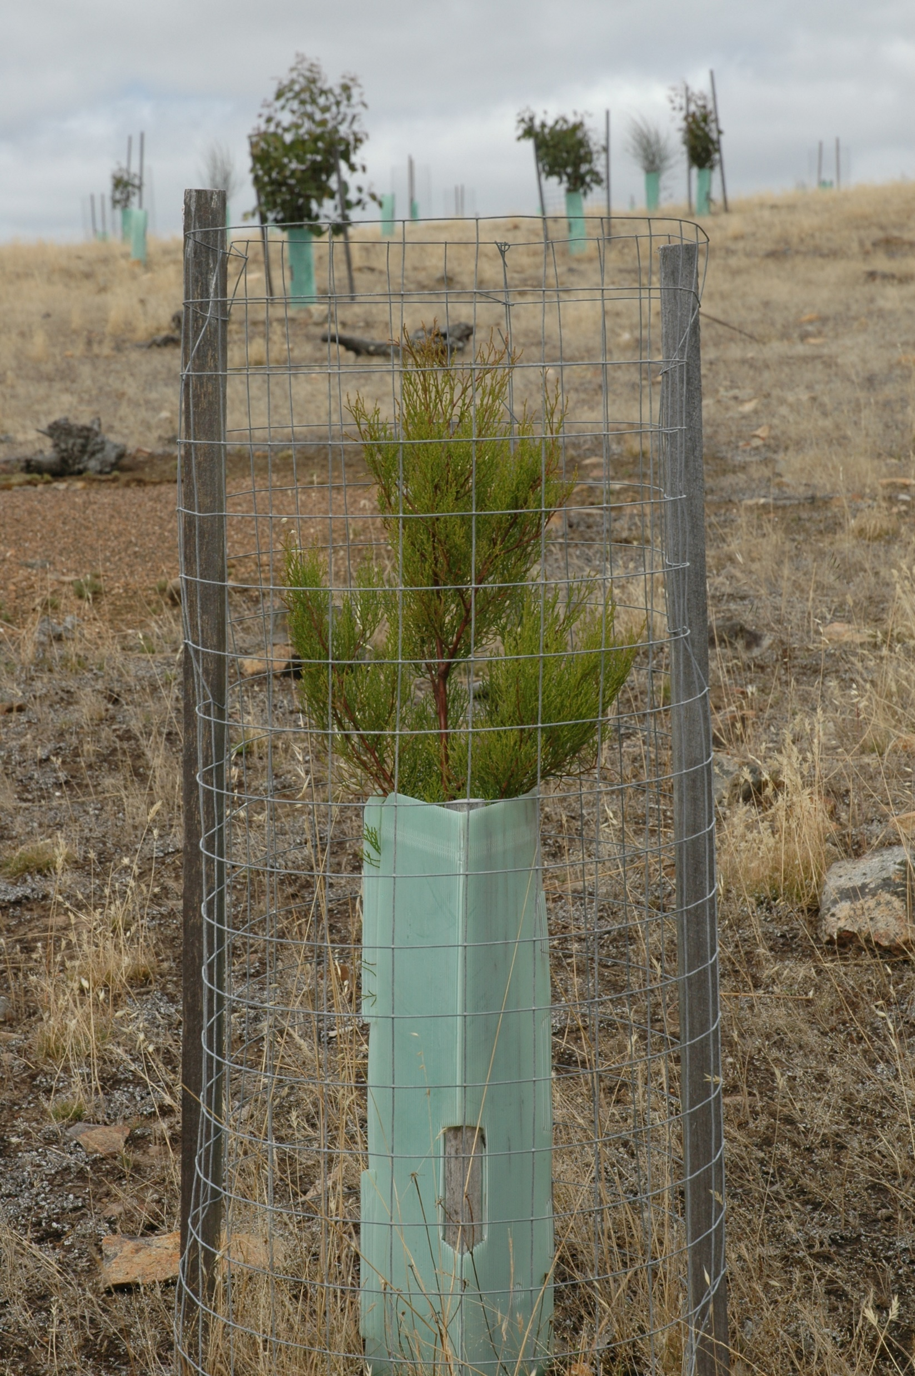

Slide 21
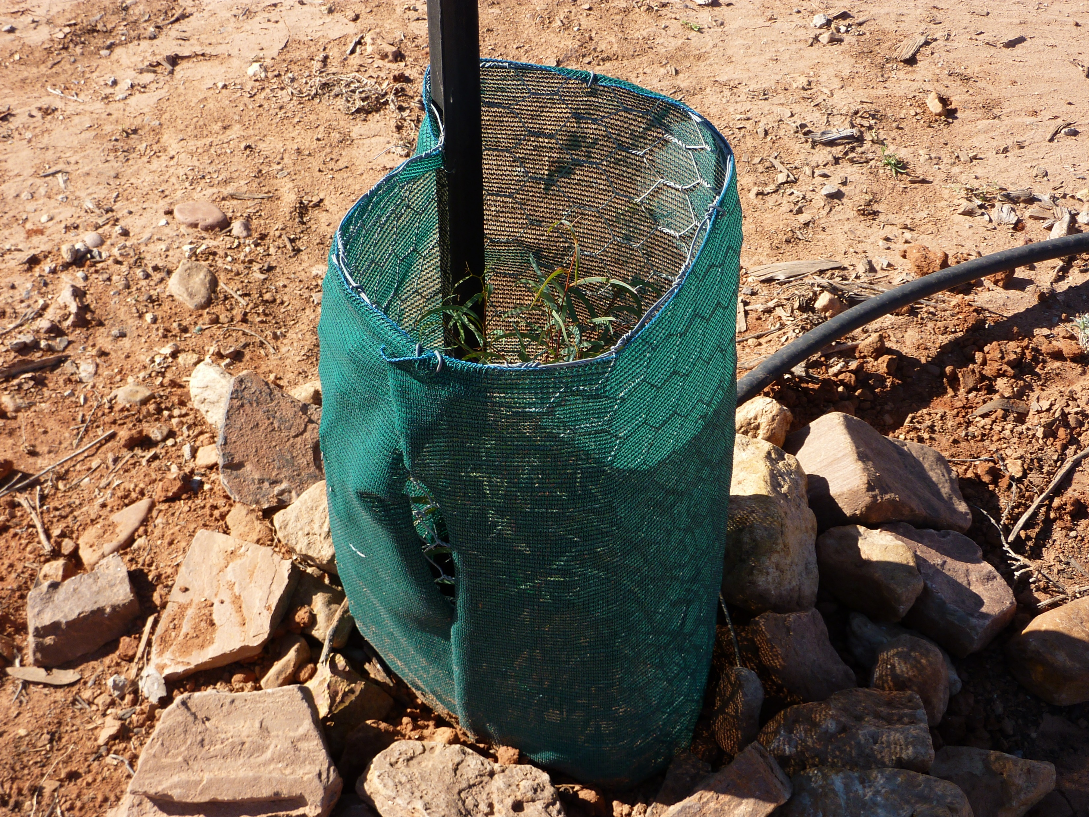

Slide 22
Watering – how much or often?
Less frequent, deeper and slower soaking is better, but also more impractical.

Slide 23
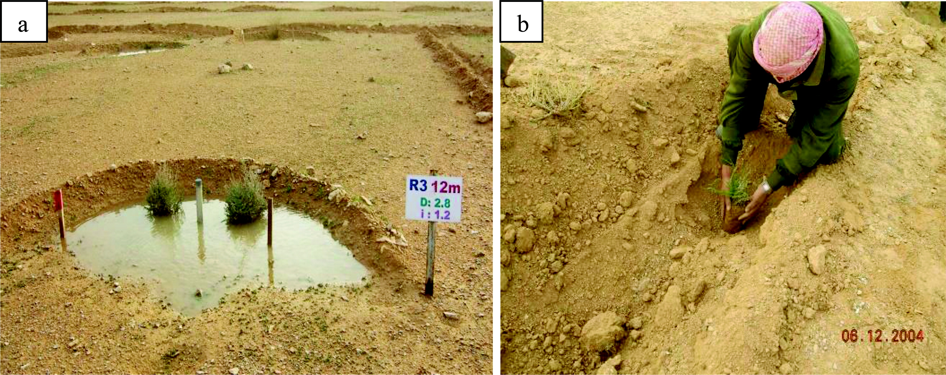

Slide 24
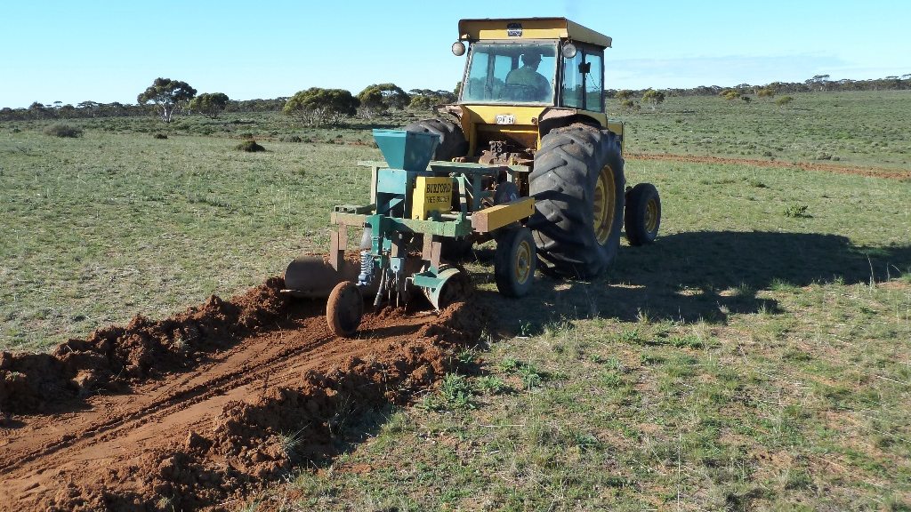

Slide 25
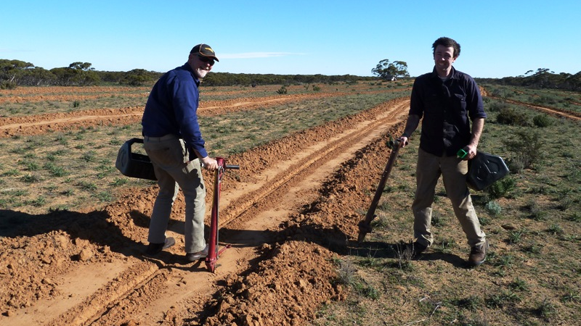

Slide 26
• What are best practices for revegetation in these areas?
  ­ Exploit natural regeneration.
    ­ Time.
    ­ Fencing (don’t rely on treeguards).
  ­Incorporate direct seeding (with appropriate species – groundcovers: low saltbushes and native grasses).
  Appropriate species selection, timing, planting methods and site preparation.
  Perforated* (compostable*) treeguards.
  ­ Mulch* (care with colour, proximity and content).
  ­ Soil wetters, if appropriate.
  ­ Rainfall harvesting with supplementary watering.
  ­ Beware of fertilisers and water crystals.

Slide 27
• What are best practices for revegetation in these areas?
  ­ Be clear about what you are trying to achieve, e.g., the purpose of your project.
  ­Be realistic – “time goes slowly out here” (P Barron :D).
  Consider site history and condition as much as possible.

