Slide 1








Landcare

Slide 2




What is landcare
Landcare Australia
VISION: All Australians actively caring for the land and water that sustains us.
PURPOSE
Empowering individuals and communities
Sustainable management of natural and productive landscapes
Building resilient ecosystems and communities
Notes:
VISION
All Australians actively caring for the land and water that sustains us.
PURPOSE
Empowering individuals and communities
Sustainable management of natural and productive landscapes
Building resilient ecosystems and communities
ABOUT LANDCARE AUSTRALIA
Landcare Australia is a national not-for-profit organisation established more than 30 years ago that supports the landcare community with funding, capacity-building, on-ground projects, information, networking and promotion of landcare achievements.
Together with the landcare community, our efforts improve biodiversity, build resilience in Australia’s food and farming systems, and create stronger communities. As a leader in the environmental sector, Landcare Australia has strong expertise in designing, managing and completing challenging and complex major ecological restoration projects involving large scale revegetation and carbon abatement.
Established in 1989 by the late former Prime Minister, the Hon. Bob Hawke AC, Landcare Australia supports over 6,000 groups and 100,000+ volunteers with landcare projects that are focused on sustainable land management practices and environmental conservation.
From the coast to the country, and from urban cities to the outback, landcare’s greatest asset is its people. The landcare movement is diverse and encompasses farmers and farming systems groups, landowners, Landcare groups and networks, Traditional Owners, Bushcare and ‘Friends of’ groups, Coastcare, Dunecare and Rivercare groups, Landcare facilitators and coordinators, youth groups and other community groups involved in protecting, enhancing or restoring their local environment. The Junior Landcare program provides a pathway for children to become lifelong landcarers starting with early learning childhood centres through to primary and secondary schools.
Landcare Australia has worked collaboratively with federal, state and local governments and their agencies, Landcare peak bodies, corporate and philanthropic partners, sponsors, community groups and individuals to support the landcare community. This long-standing engagement with local community-led environmental initiatives has led to the organisation’s renowned reputation and trust by Australians.
Landcare Australia develops campaigns in partnership with stakeholders to:
support the sharing of knowledge and promote the development of community leadership and resilience;
recognise and celebrate the achievements of the landcare community;
encourage participation in landcare activities and the recruitment and retention of volunteers;
attract government, corporate and philanthropic funding and in-kind support for good quality, hands on projects and programs that will improve environmental outcomes; and
support the adoption of sustainable agriculture practices that will deliver a more productive and profitable agriculture industry.
For over 30 years, Landcare Australia has worked at the forefront of community and corporate engagement in natural resource management and environmental project delivery. Custodian of the ‘caring hands’ logo, Landcare Australia manages the Landcare, Coastcare, Junior Landcare and Landcare Farming brands on behalf of the landcare movement. The Landcare brand is recognised and trusted, with consistently positive attitudes in local communities towards landcare projects, and 78% awareness among Australians of the landcare ‘Caring Hands’ logo.
The funding and in-kind contributions raised from partnerships and sponsors supports Landcare Australia to develop programs that are practical, deliverable and community focused.
Through this support Landcare Australia achieves a diverse range of positive environmental and community outcomes, these include:
a sustainable approach to integrated land management
environmental protection, enhancement and conservation of land, water, waterways and coasts
natural habitat restoration to enhance biodiversity
building resilience in Australia’s food and farming systems
creating social cohesion and wellbeing in communities.
With the impact of a changing climate, and natural disasters like drought, bushfires and flood, landcare has never been so important.
What makes Landcare Australia unique to any other national environmental organisation is effective partnerships and people. Across Australia, our partnerships support thousands of people involved in Landcare who are volunteering to protect local ecosystems that contribute to the sustainability and productivity of our land and water assets for the benefit of all Australians.

Slide 3
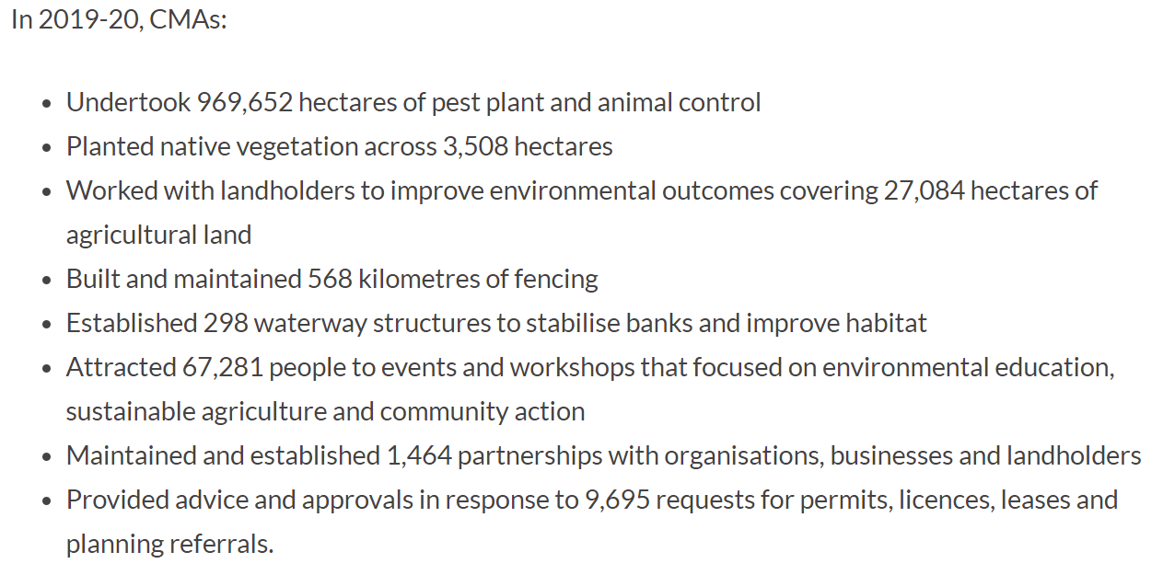
What is Landcare
NFP that supports the landcare community with funding, capacity-building, on-ground projects, information, networking and promotion of landcare achievements.
expertise in designing, managing and completing challenging and complex major ecological restoration projects involving large scale revegetation and carbon abatement.

Slide 4

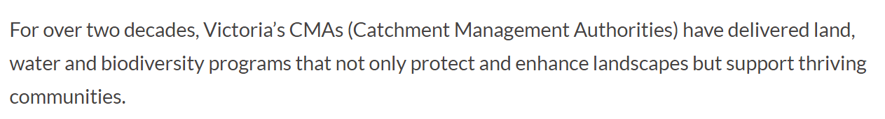
Who does it involve
Works collaboratively with federal, state and local governments
encompasses farmers and farming systems groups, landowners, Landcare groups and networks, Traditional Owners, Bushcare and ‘Friends of’ groups, Coastcare, Dunecare and Rivercare groups, Landcare facilitators and coordinators, youth groups and other community groups involved in protecting, enhancing or restoring their local environment.

Slide 5


Contacts we already know?
Brainstorm
Who do we already know from each of these different areas:
Farmers
Farming group
Landowners
Landcare groups
Landcare networks
Traditional owners
Bushcare / friends groups
Coastcare
DuneCare
Rivercare
Landcare Facilitators
Youth Groups
What other groups / networks do we know of?
  TFL?

Slide 6



Federal / State Govt
Funding usually originates from federal/state govt schemes
Catchment Management Authorities (VIC)
Landscapes SA (SA)
Local Land Services (NSW)
These boards are usually govt boards and facilitate the funding of community networks and groups working in the environmental sector
Landcare Network
The network facilitator is the one to talk to - they know what every group is up to
e.g. current funding for people in drought and fire affected areas
These boards often employ or fund the facilitators that work for landcare networks and coordinate all the funding and projects for the groups
Landcare Groups
Friends of Groups
Structure of Funding

Slide 7
What do they do?
https://landcareaustralia.org.au/30-things-landcare-do/
Projects they engage in
Land management
Environmental protection – enhancement and conservation of land, water, waterways and coast
Enhance biodiversity through natural habitat restoration
Resilience in our food and farming systems
Social wellbeing in communities

Slide 8
How can we help them?
We can best help them by:
Speed of response
Understanding
Providing accurate information
Products they need

Slide 9
Products?
What products will they need from us?
What can we provide them that will make their lives
Easier faster or cheaper?

