Slide 1





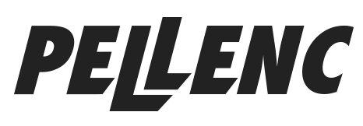


Poisons

Slide 2
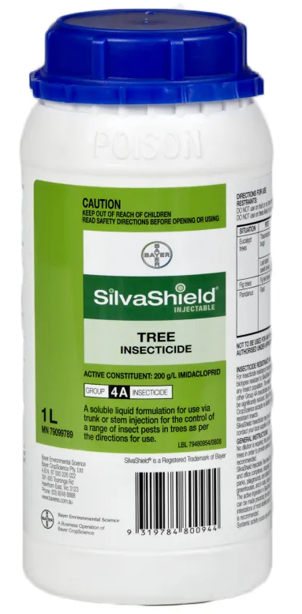


Silvashield
Product information:
Systemic poison
Injected into tree trunks
Commonly used for Elm Beetle
Do not use in orchards or on edible plants

Slide 3
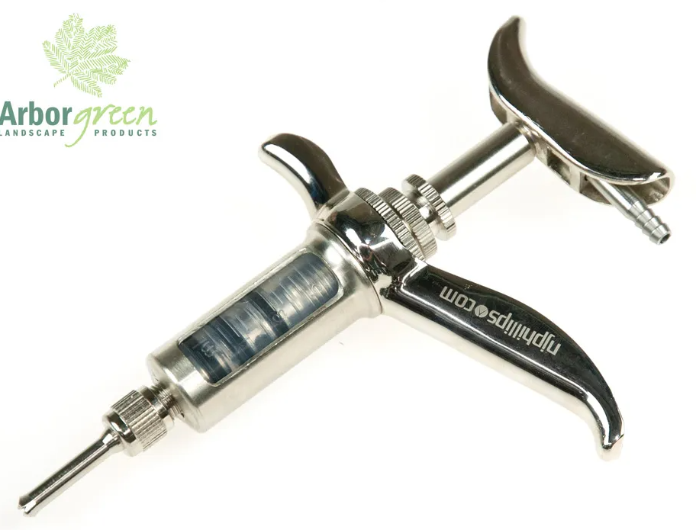
Tree injector
Product information:
Used for Silvashield and occasionally drill and fill
Quite practical for Silvashield
Tends to clog up when used with glyphosate
Needs oiling regularly

Slide 4
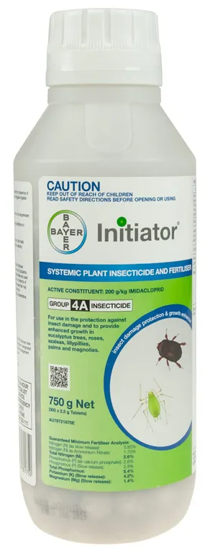
Initiator tablets
Product information:
Systemic poison
Placed in the soil adjacent to infested plant
Commonly used with potted or newly planted trees, also used on mature trees at a rate of 1 tablet per 1 metre of plant height
Do not use in orchards or on edible plants

Slide 5
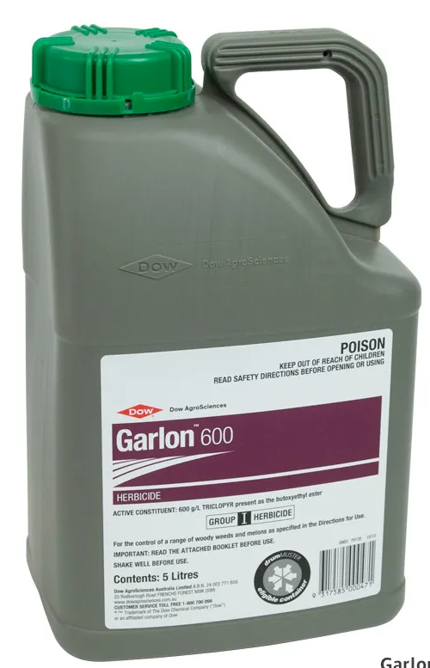
Garlon
Product information:
Selective systemic poison
Spot spray control of woody weeds
Commonly used for Blackberry, Broom, Gorse etc
Significant improvement when used with sticker/oil

Slide 6
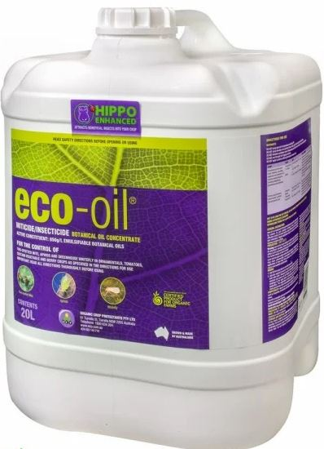
Eco-Oil
Product information:
Contact poison
Organic spray control of insects
Commonly used for Citrus Leafminer, Scale and various sapsucking insects in vegetable and ornamental plants

Slide 7
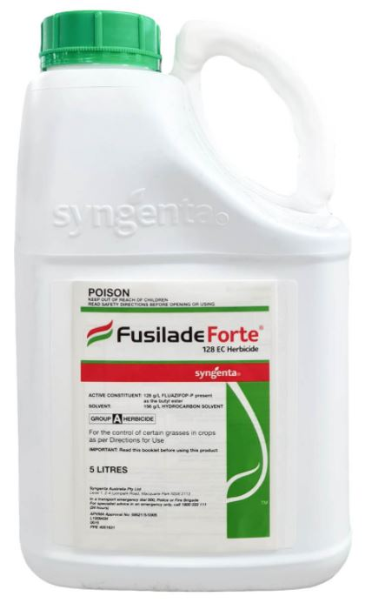
Fusilade
Product information:
Selective systemic poison
Spot and boom spray of many grass species
Commonly used for grass control in crop or orchard situations
Will not work on all grasses

Slide 8
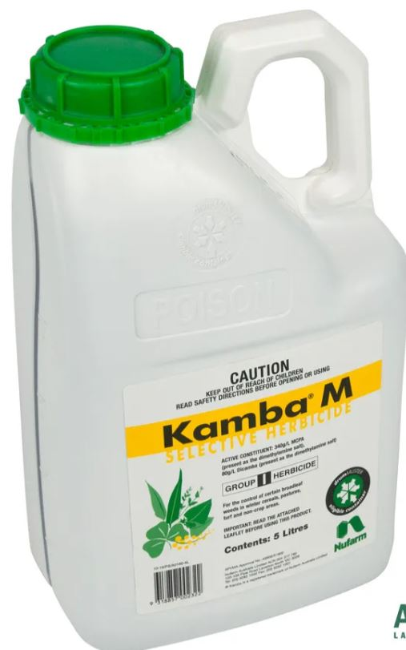
Kamba M
Product information:
Selective systemic poison
Spot and boom spray of many broadleaf species
Commonly used for broadleaves in crop or orchard situations, also excellent for broadleaf in lawns (do not use on Buffalo grass)
Will not work on all broadleaves

Slide 9
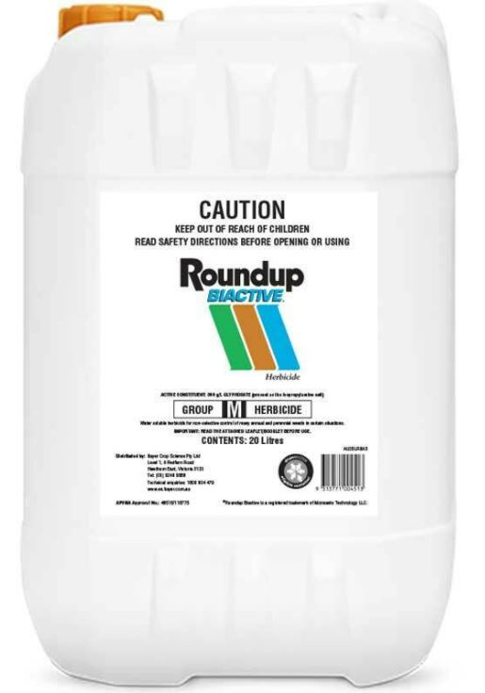
Roundup Biactive
Product information:
Non-selective systemic poison
Spot spray of many herbaceous weeds
One of the most popular total-kill herbicides
Benefits significantly from the addition of Pulse
The only registered herbicide for use over water*
*debatable if it actually doesn’t effect frogs

Slide 10
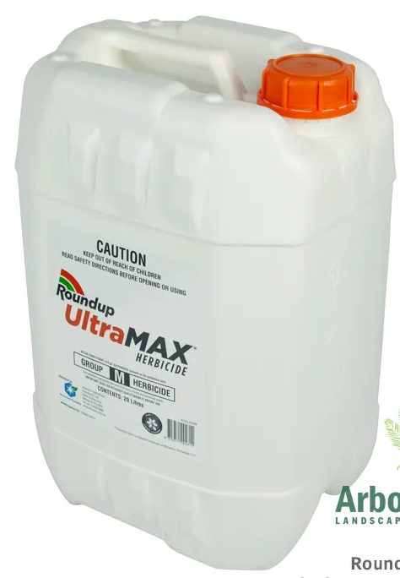
Roundup Ultramax
Product information:
Non-selective systemic poison
Spot spray of many herbaceous weeds
The best product for drill and fill of woody weeds, mixed at a ratio of 1:1
Benefits significantly from the addition of Pulse

Slide 11
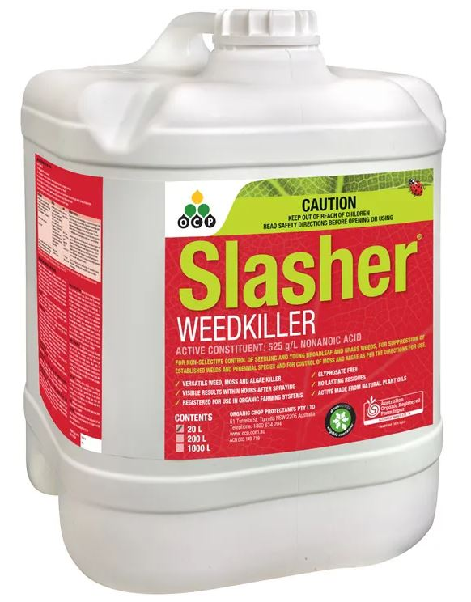
Slasher
Product information:
Non-selective contact poison
Spot spray of many herbaceous weeds
Completely organic
May take several applications to kill stronger weeds

Slide 12
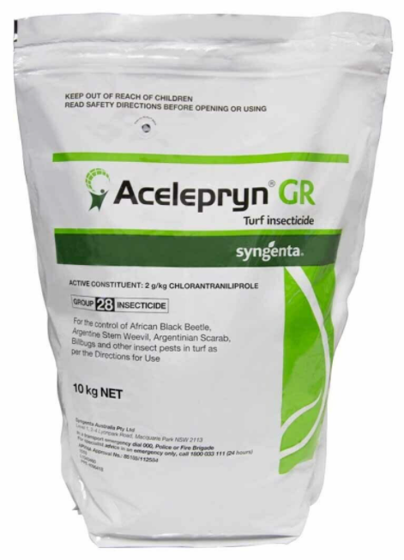
Acelepryn
Product information:
Non-selective systemic poison
Granular control of lawn insects
Great for African Black Beetle
Provides long term control

Slide 13
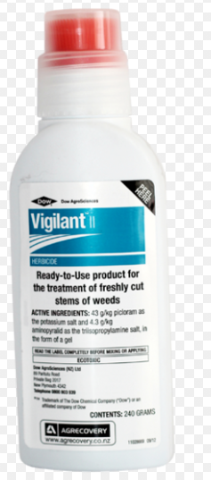
Vigilant
Product information:
Selective systemic poison
Gel control of woody weeds via cut and swab
Great for many deciduous and evergreen trees
Has size limitations in its effectiveness

Slide 14
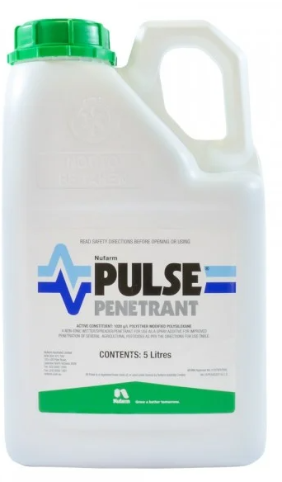
Pulse
Product information:
Spray adjuvant – penetrant, spreader and wetter
Compatible with glyphosate and similar products
One of the best penetrants on the market
Significantly improves uptake and efficiency of herbicide

Slide 15
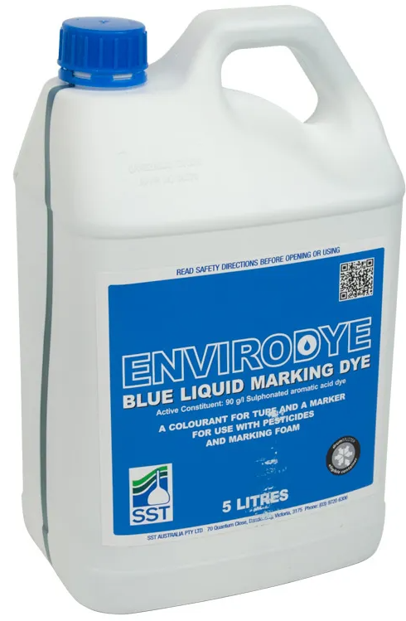
Envirodye
Product information:
Spray adjuvant - colourant
Compatible with all aqueous spray solutions
Also available in red

Slide 16
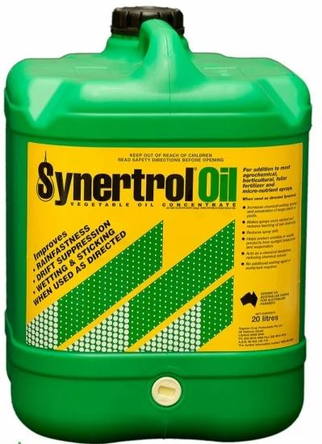
Synertrol
Product information:
Spray adjuvant – sticker and wetter
Compatible with some aqueous spray solutions

