Slide 1



Pole equipment

Slide 2
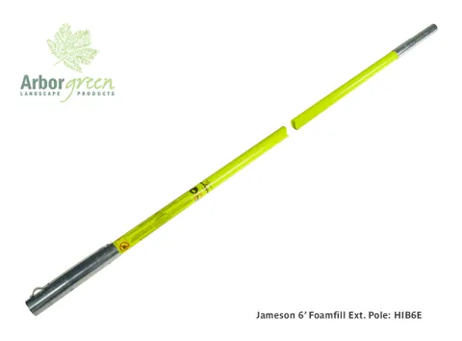


Jameson Pole
Foam filled fiberglass – prevents debris and moisture build up inside pole and also adds to the strength
Not a “hot stick” pole
The poles in 6ft and 8ft are stackable
Made in a high vis colour
Used by arborists for tree pruning around power lines

Slide 3
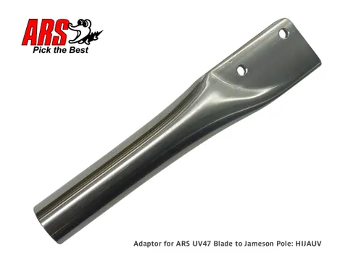
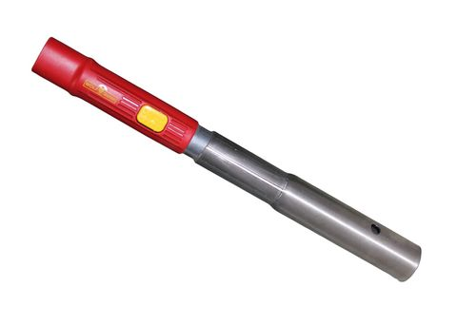
Adaptors to suit
This adapter allows you to utilise your Wolf Pole Lopper or Pole Saw
ARS Pole saw adapter

Slide 4
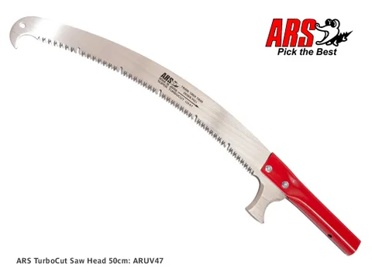
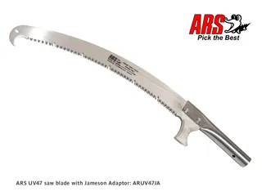
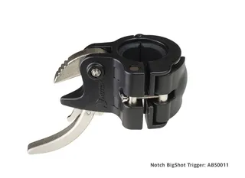
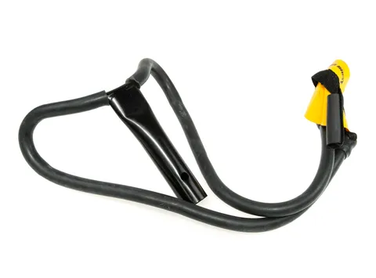
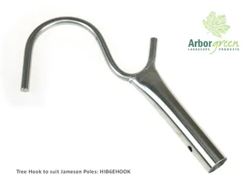
Suitable attachments

Slide 5
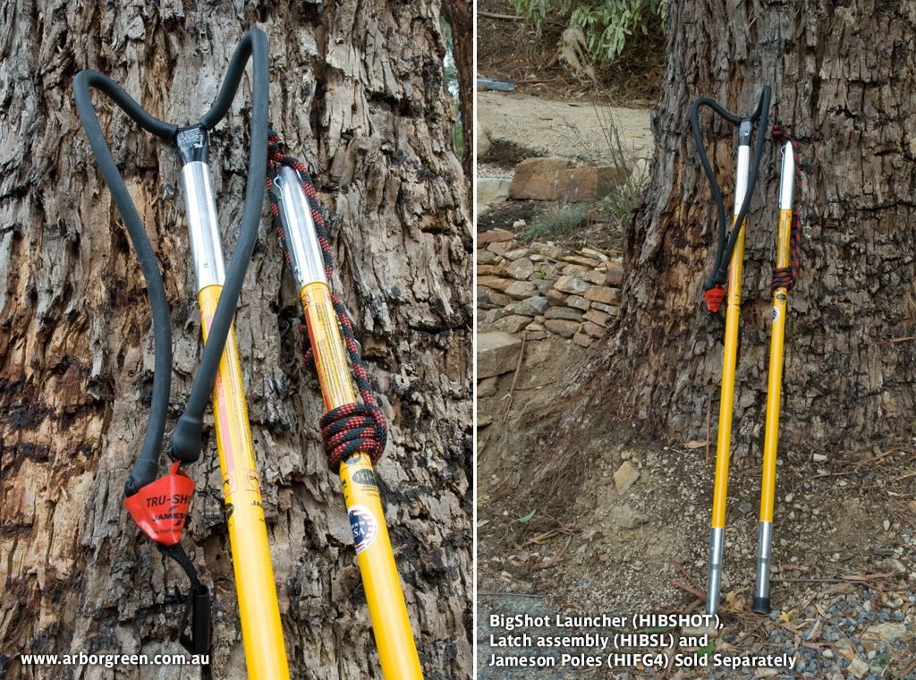
Hollow 4ft extension pole
Mainly used for the big shot
Compatible with the same adapters as the foam pole

Slide 6
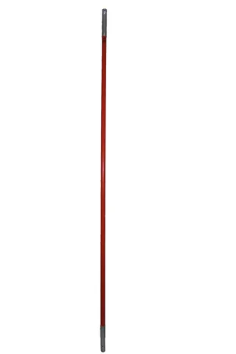
Marvin Fibreglass pole 8ft
Mainly used for the big shot throw bag
Compatible with any of the Jameson adapters and fittings

Slide 7
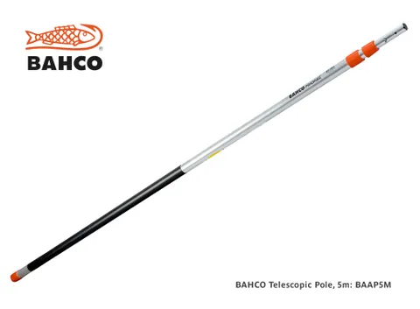
Bahco Telescopic Pole
Length extends to 5 meters
Fits all BAHCO top pruners and pole saws
Simple twist and lock mechanism
Lightweight
AP aluminum (Fiberglass is available upon request)

Slide 8
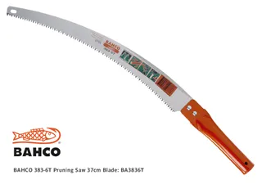
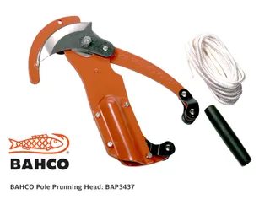
Suitable attachments

Slide 9
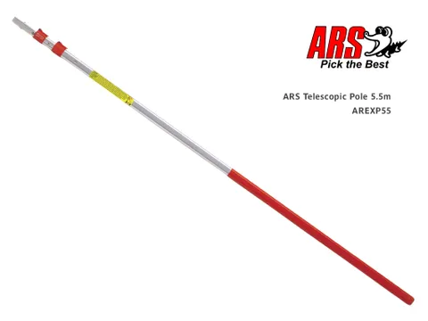
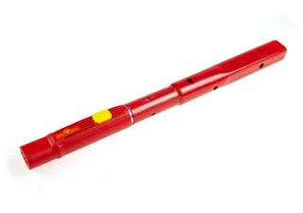
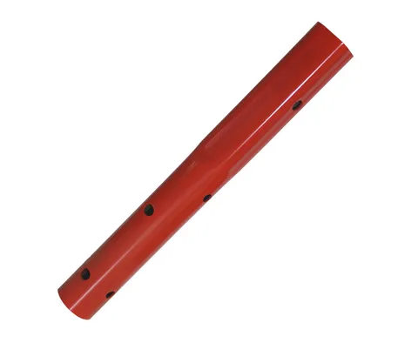
ARS Telescopic Poles
Extends to a 4.5m or 5.5m length
Super light weight
Clip lock mechanism
ARS pole to Wolf attachments
Adaptor to fit BACHO lopper to ARS

Slide 10
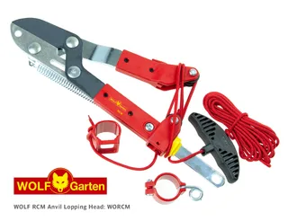

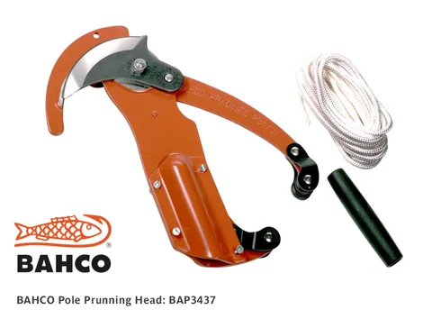
Suitable attachments

Slide 11
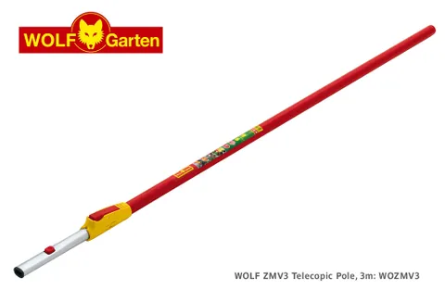
Wolf Telescopic poles
PVC sleeve
Comes in a 3m & 4m telescopic
Has the largest variety of different head to attach
High quality aluminum

Slide 12
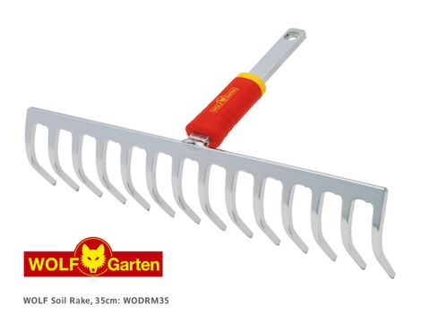
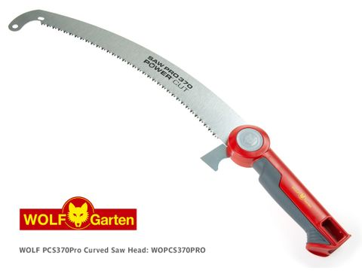
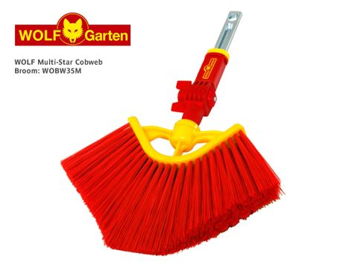
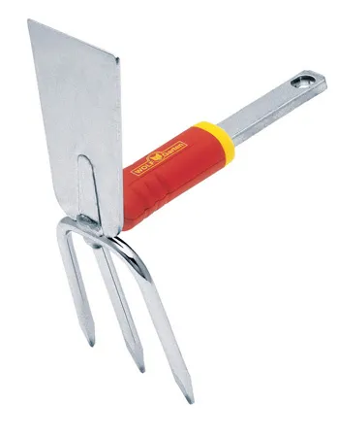
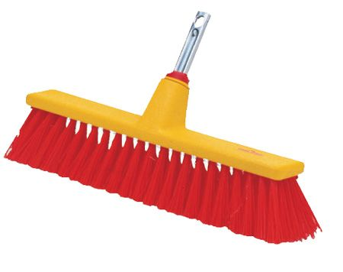
Wolf attachments

