Slide 1







ARS (not arse)

Slide 2
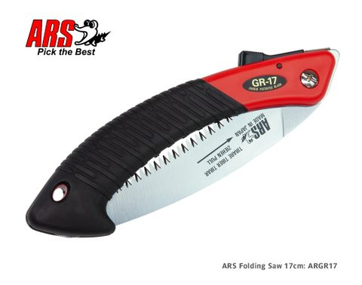


Saws
Range of saws from 17cm to 50cm
2 small folding saws the GR17 and Z17 main difference is the curved blade on the cooler one (grippy handle)
Variety of blade types and hardnesses most coming with sheaths.
The GR17 is the best selling with more than 3500 units selling since January last year
All replacement blades and parts are available

Slide 3
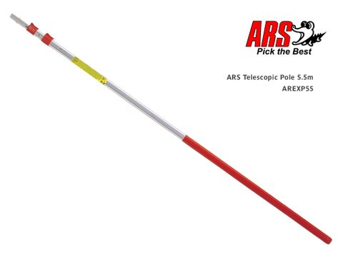
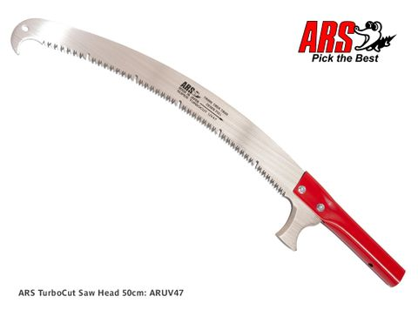
Saws (But Long)
The UV47 is the largest saw
Most commonly paired with extension poles like the
ARS or other poles from our last toolbox talk. Different
Adaptors to make it work
Has a hook and bark cutter making it incredibly useful and versatile for tree work
Someone might know this but there was a smaller saw that used to suit the poles

Slide 4
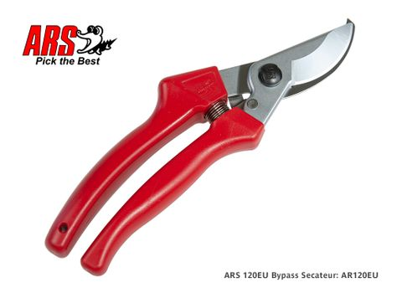
Secateurs
Wide range of secateurs, most commonly used for flowers or light pruning/gardening jobs
The 120eu is the best seller at over 6000 since January last year most likely due to their lower cost and high quality making them more approachable
Most of the secateurs are bypass excluding the newish anvil versions
Different sizes and handle types available such as roll handle although the heads are not mix and match like Bacho if the handle is a larger size so is the blade

Slide 5
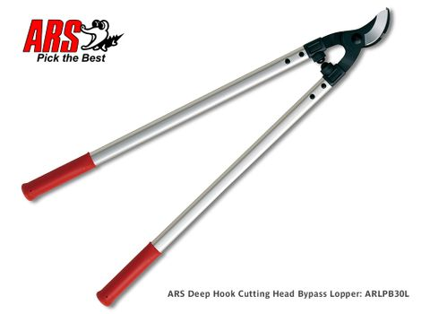
Secateurs (But Big)
Pretty self explanatory
Bypass and anvil versions
Plenty of sizes to chose from for whatever you are needing to cut through
Lightweight aluminum handles but still strong

Slide 6
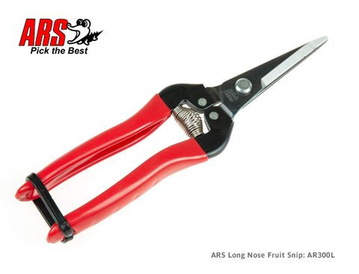
Snips
I dunno they are like scissors but a bit bigger and they are smaller than secateurs
Lots of types
As mentioned on my fruit picking talk the different type of steel used can make a difference on where and how they are used.

Slide 7
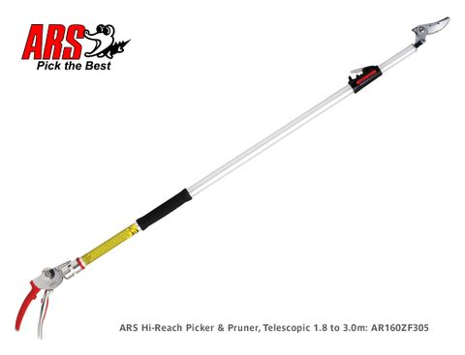
Long Reach
We have a variety of long handled pruners and fruit picking pruners with a cut and hold function
Is also a long reach lopper with more grunt for bigger diameters.

Slide 8
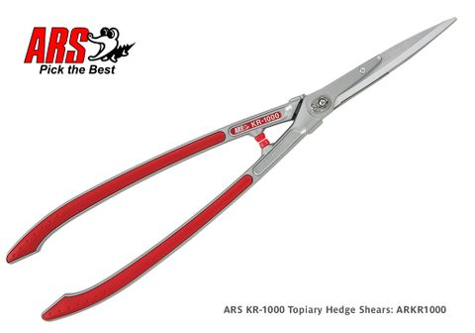
Hedge Shears
The Hedge shears or more accurately Topiary shears designed for more fine detail hedge trimming
Come in 3 different sizes including a telescopic handle version
Not made for lopping of anything over 10mm due to the fineness of the blades

Slide 9
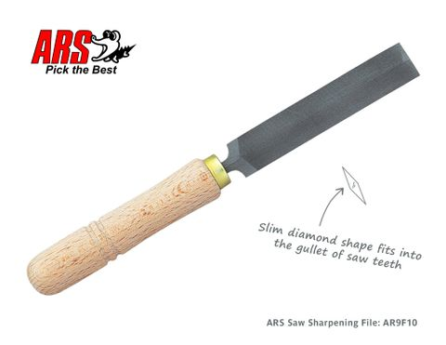
Bits and Bobs
We have access to a whole lot of spare parts which is probably my favourite/least favourite thing about ARS
Some cool accessories such as the saw sharpening file and leather pouches
I also have a very old ARS polo shirt that I wear sometimes when I am gardening

Slide 10
Sales and Stuff

