Slide 1







Tree Root Control Products

Slide 2
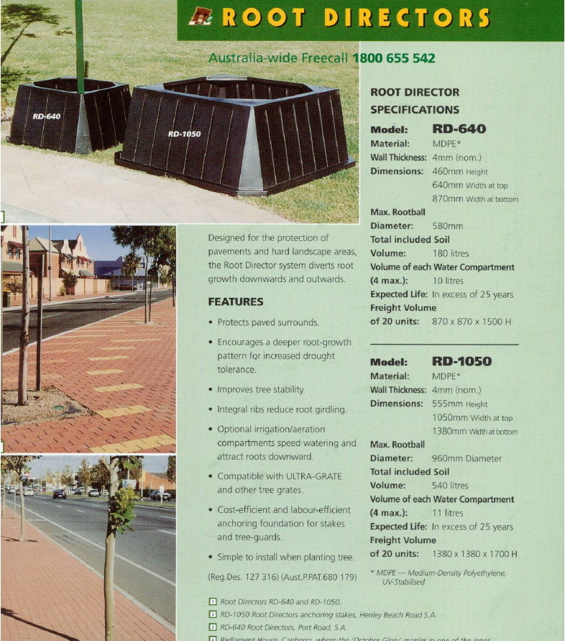


RootDirectors
History-
Original ‘Square’ RD640 and RD1050 manufactured from approx. 1995 by Anstey Products in Mt Gambier SA

Slide 3
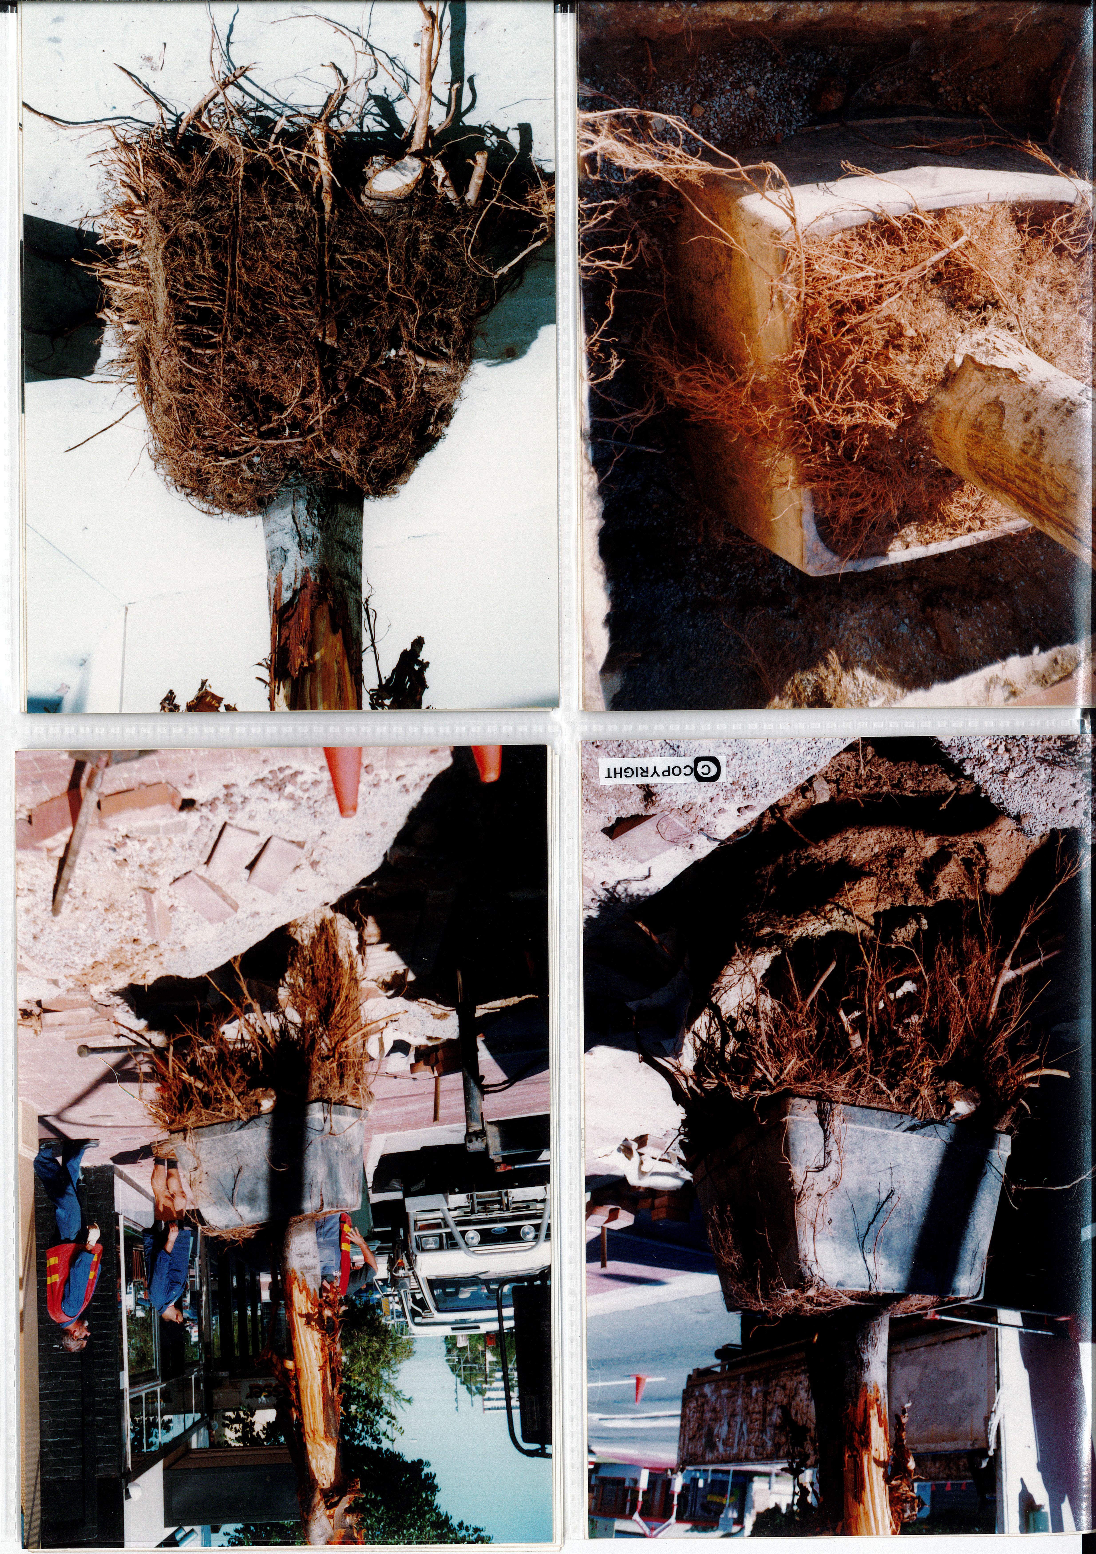
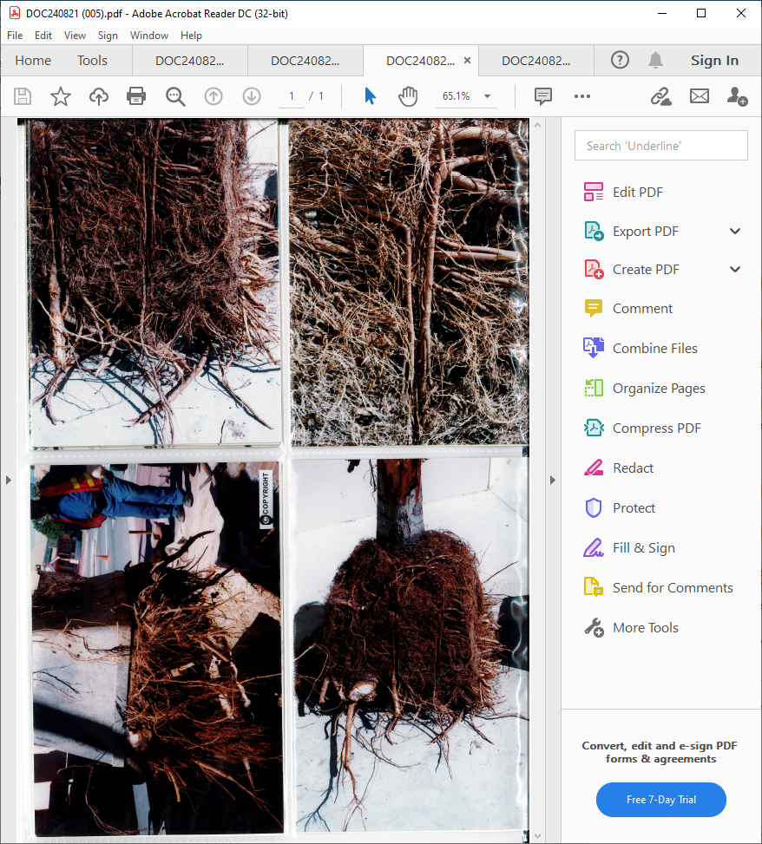
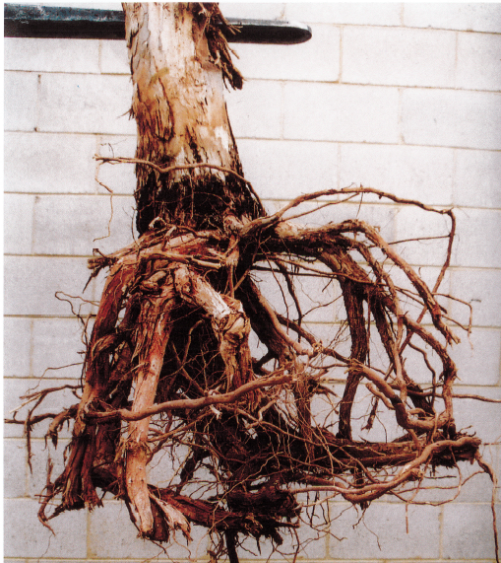
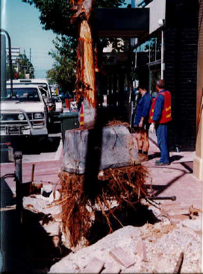

RootDirectors
History-
Excavation Trials- an old USA built DeepRoot Planter in Woodville Ccl (Now Charles Sturt) in very early 1990’s

Slide 4
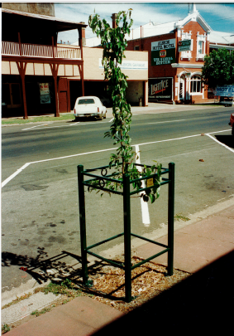
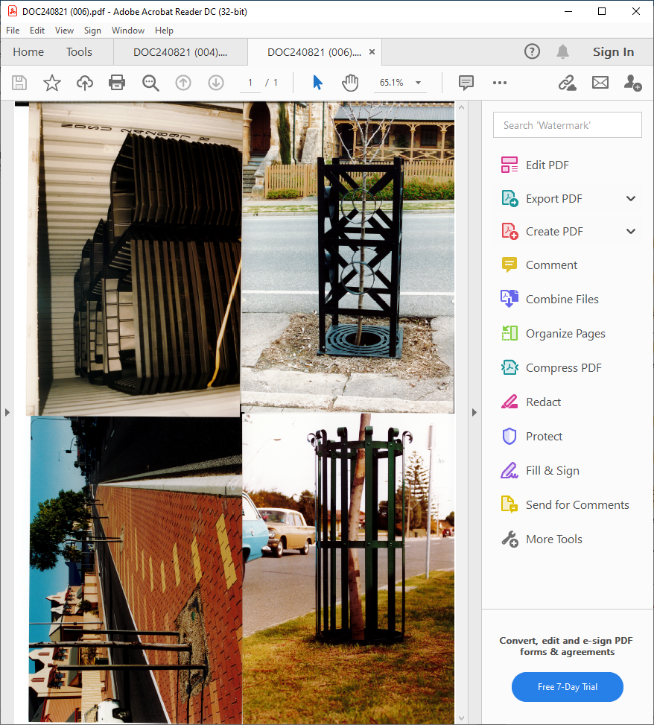
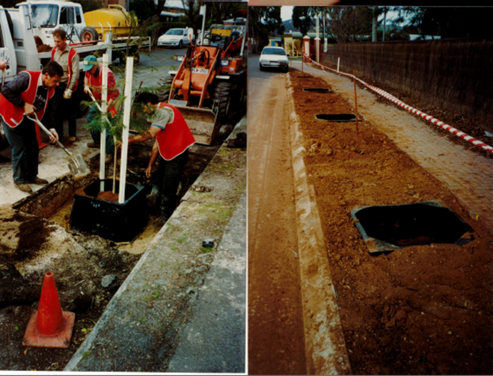
RootDirectors
History-
Old Installations in Adl in late 90’s

Slide 5
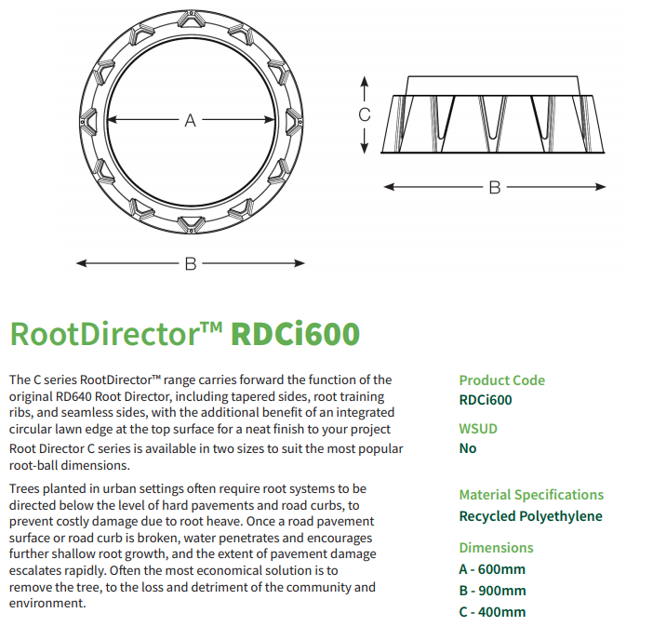
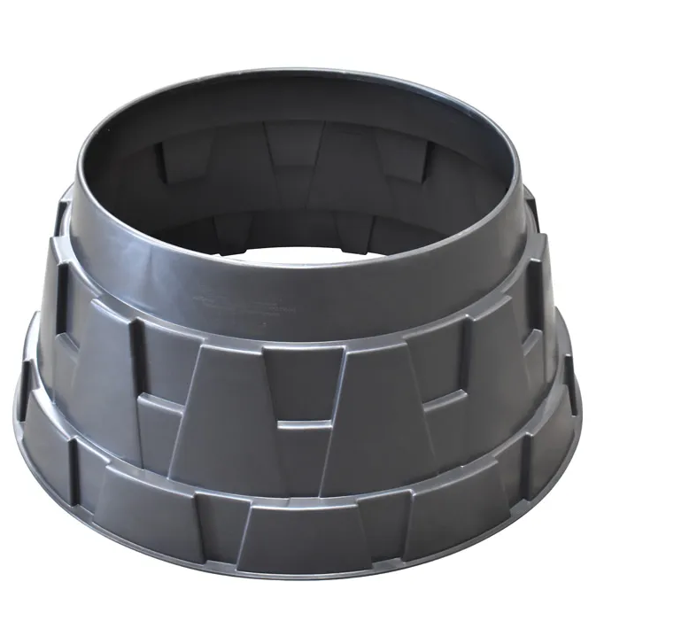
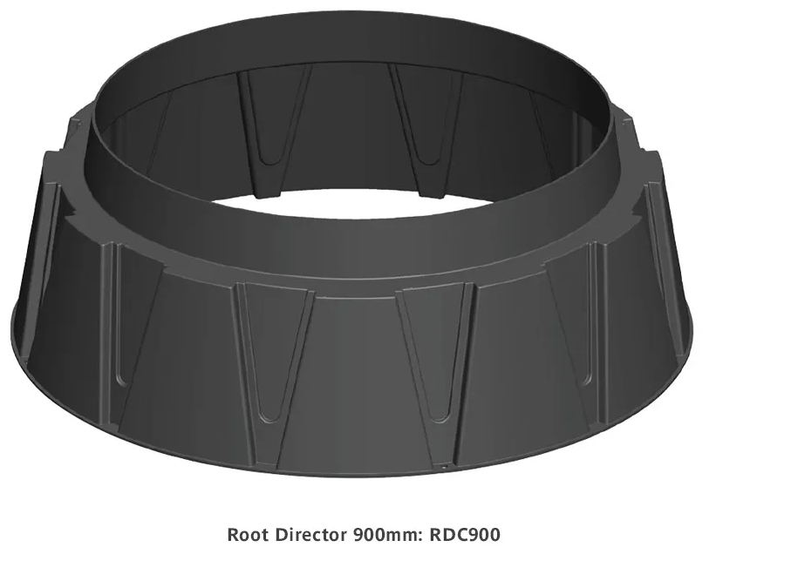
RootDirectors
History-
Current RDCI600 and RDC900 (Round) from CityGreen

